Slide 1

Physical Flow Accounts
Notes:
Note that some of the participants may know more about physical flow accounting than the presenter. However, this introduction is very helpful to ensure everyone has the same basic knowledge.

Slide 2


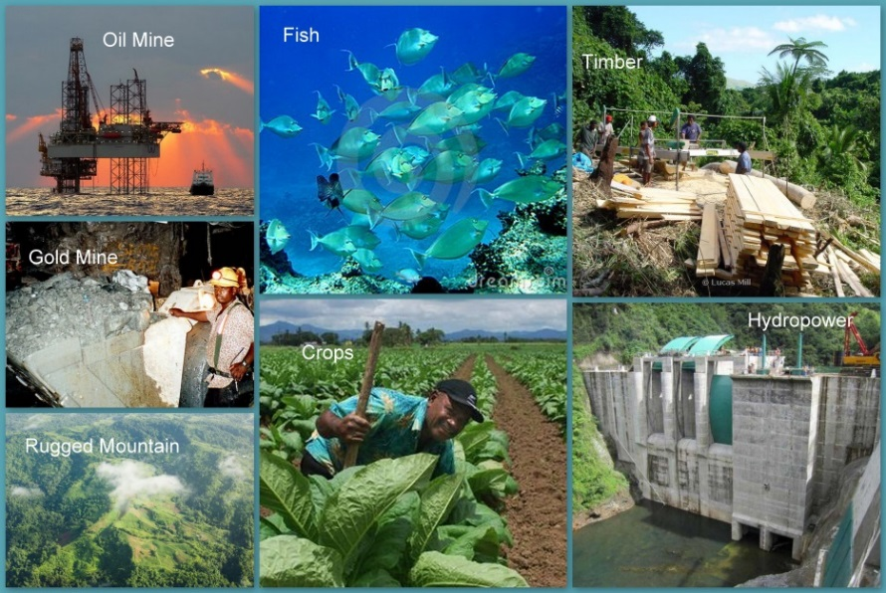
Outline
Outline
Learning objectives
Level 1 What? Why? (compilers)
  Concepts (25 min.)
  Group exercise and discussion (30 min.)
Level 2
  Concepts (25 min.)
  Group exercise and discussion (30 min.)
Notes:
See link to YouTube video…

Slide 3
Learning objectives
1. Learning Objectives
Level 1
  Understand what Physical Flows are and why they are important
  Be familiar with the basic concepts
  Understand how treated in the SEEA
  Learn the steps of compiling Physical Flow Accounts
Level 2
  Understand further concepts required
  Learn about data sources and measurement challenges
Notes:
Energy, Water, Solid Waste, Air emissions, Wastewater, Asset Accounts (Minerals & Energy, Land, Soil, Timber, Aquatic Resources, Other Biological Resources, Water)

Slide 4
What is Physical flow accounting?
2. Level 1
Natural inputs are extracted and harvested to create
Environment
Products, which are consumed, accumulated and discarded, in the process creating
Economy
Natural Inputs
Establishments
Households
Government
Natural Resource Residuals
Products
Residuals as by-products of production, consumption and accumulation including
Residuals
Imports/Exports
Accumulation
Natural resource residuals (unused natural inputs)
Rest of the world

Slide 5
Environment accounts and statistics
2. Level 1
SEEA-CF (Central Framework) | Assets Physical flows Monetary flows | Minerals & Energy, Land, Timber, Soil, Water, Aquatic, Other Biological Materials, Energy, Water, Emissions, Effluents, Wastes Protection expenditures, taxes & subsidies
SEEA Water; SEEA Energy; SEEA Agriculture, Forestry and Fisheries | Add sector detail | As above for Water Energy Agricultural, Forestry and Fisheries
SEEA-EEA (Experimental Ecosystem Accounting) | Adds spatial detail and ecosystem perspective | Extent, Condition, Ecosystem Services, Carbon, Water, Biodiversity
FDES (Framework for the Development of Environment Statistics) | Basic statistics for above plus… | Extreme events and disasters Human settlements and health Protection, management & engagement
Notes:
Six SEEA accounts are required in EU Countries by legislation: Air emissions, material flows, energy, EPE, EGSS, taxes & subsidies,
http://ec.europa.eu/eurostat/statistics-explained/index.php/Environmental_accounts_-_establishing_the_links_between_the_environment_and_the_economy
The SNA 2008 is 722 pages
The SEEA-CF is only 346
The SEEA-EEA is only 198

Slide 6
Physical Flow accounts
2. Level 1
Environment
Stocks
Minerals & energy Timber Aquatic Other biological
Minerals & energy
Water
Flows
Materials
Energy
Water
Economy
Residuals
Solid waste
Air emissions
Effluents
Notes:
It’s difficult to account for all natural inputs, products and residuals at once, so we group them…

Slide 7





Accounts “balance the books”
2. Level 1
Source statistics
Example: Water abstracted by municipal water supply
Water used for irrigation
Methods, concepts and classifications
Units of measure
Accounting periods
Harmonize, integrate, improve source statistics
Different sources & use
Show data gaps, duplication, inconsistencies
Fill data gaps (estimation)

Slide 8
Accounts “balance the books”
2. Level 1
Source statistics, e.g.:
  Water abstracted by municipal water supply
  Water used for irrigation
Come from different sources & use different:
  Methods, concepts and classifications
  Units of measure
  Accounting periods
Accounts harmonize, integrate and improve source statistics
  Show data gaps, duplication, inconsistencies
  Fill data gaps (estimation)

Slide 9
An actual dialogue
2. Level 1
I put the numbers into my Physical Supply and Use table for Water.
OK, but why did it increase by 500% in the nuclear energy sector?
I’ll ask the methodologist.
Total water use in the power generation industry increased by 10% over last year!.
Water use in the power generation industry increased by 15% over last year!
How do you know?
Some responses are 1000 times higher this year. They must have mixed up the units
SEEA Manager
Survey Manager
Methodologist

Slide 10








Uses of physical flow accounts
2. Level 1
Natural inputs
  Sustainable consumption and production
  Natural resource management (minerals, energy, water, food, timber)
  Footprint calculations
Energy
  Analyse supply/use, distribution
Water
  Analyse supply/use, distribution
Residuals
  Analyse air emissions, wastewater, solid waste
  Total quantities, main sources
Notes:
Which account links to which SDG?

Slide 11
One application: Material footprint
2. Level 1
How can high income countries be reducing?
Material footprint: the total quantity of biomass, fossil fuels, metal ores and non-metal ores extracted globally and consumed in a country.
Notes:
Answer: more efficient consumption

Slide 12
Basic concepts
2. Level 1
Physical flow accounting
Physical supply and use tables
The supply/use chain
Accounting identities
Definitions
  Natural Inputs
  Products
  Residuals

Slide 13
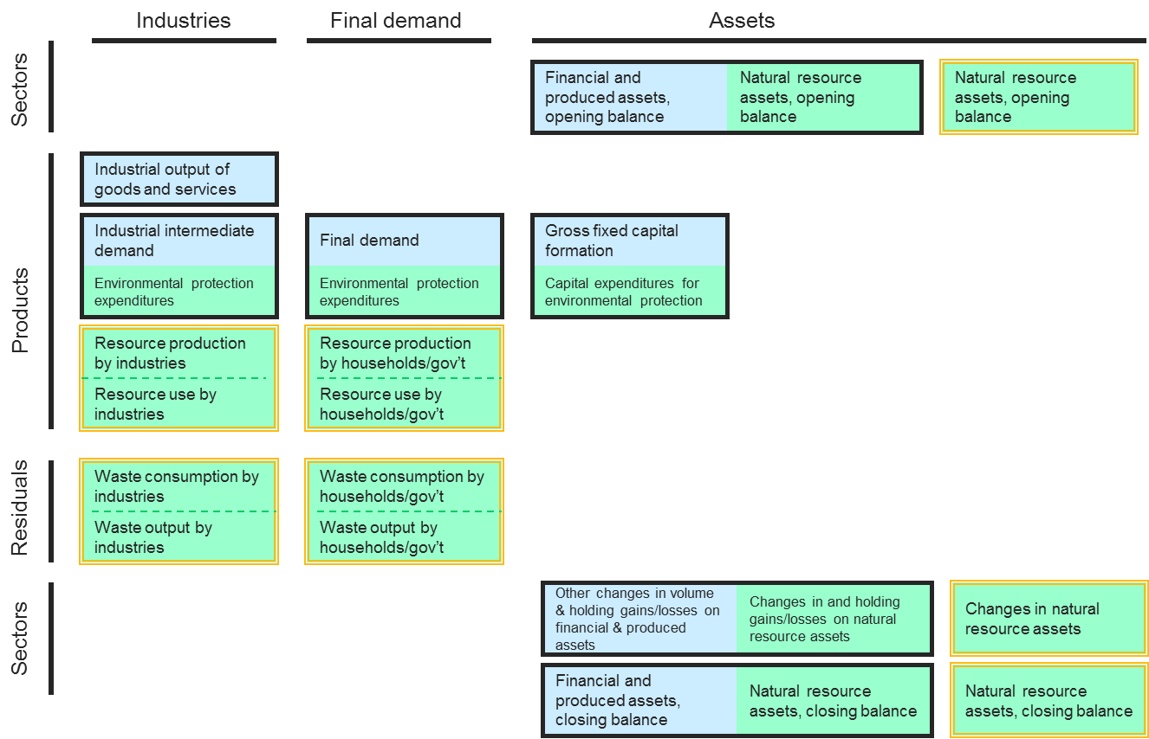
Physical flows in the SEEA
2. Level 1
Physical Flows
Notes:
Physical flows are a parallel to the Monetary Flow Accounts (between industries) already in the SNA. The SEEA adds an emphasis on residuals.

Slide 14
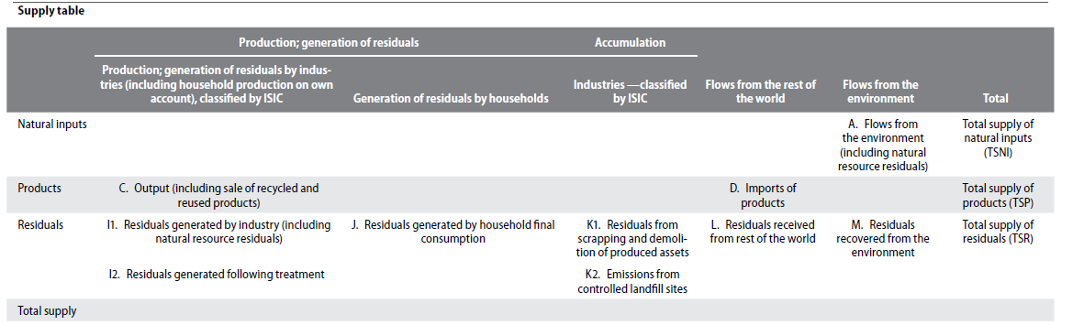
Physical supply table
2. Level 1
If households extract materials,
they are “producers”
Environment
Rest of the world
Domestic production
SEEA-CF Table 3.1
Residuals are generated from consumption or imported

Slide 15
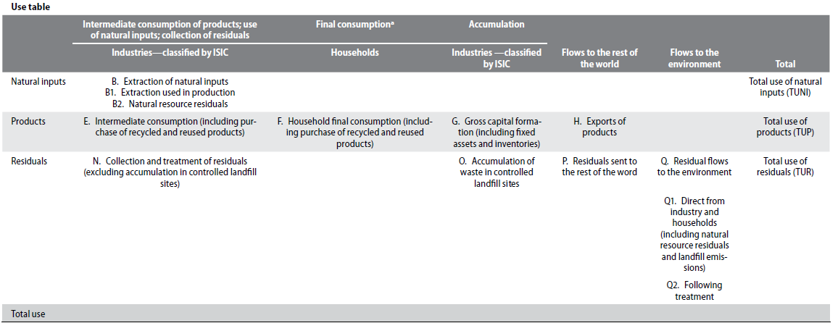
Physical use table
2. Level 1
Government final consumption is
recorded as intermediate consumption
Environment
Rest of the world
Domestic consumption and accumulation
Residuals can be reused, accumulated, exported or discarded
SEEA-CF Table 3.1

Slide 16

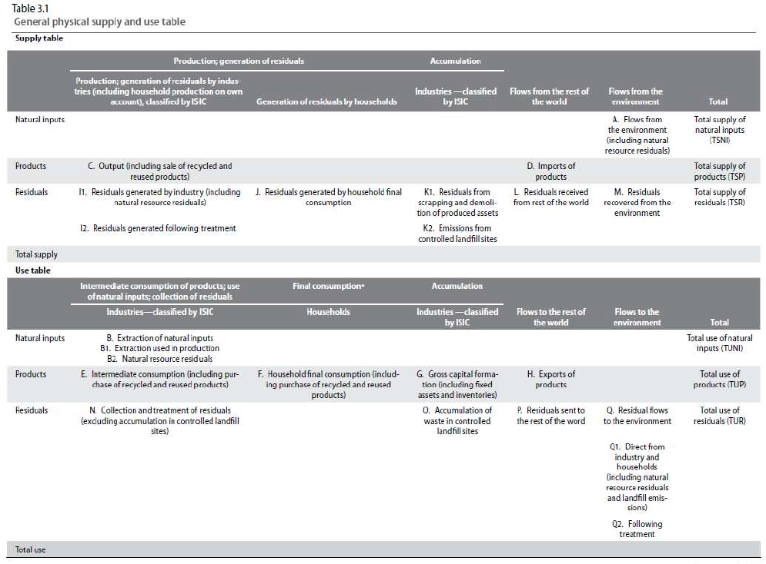
The supply/use chains
2. Level 1
Products supplied by production and imports
→ used by intermediate consumption, households, accumulation and exports
Natural inputs supplied by environment → used by extraction, harvesting, capture industries
Residuals supplied (generated) by all
→ used by collection & treatment, accumulation, export and environment
Notes:
Why is there no import of natural inputs? [imports are “products”]
Why do households not use natural inputs directly? [productive activity is in “production”]
Why do we have H. Export of products and P. Residuals sent to the rest of the world? [sold or garbage]

Slide 17
The supply/use chains
2. Level 1
Natural inputs supplied by environment → used by extraction, harvesting, capture industries
Products supplied by production and imports
→ used by intermediate consumption, households, accumulation and exports
Residuals supplied (generated) by all
→ used by collection & treatment, accumulation, export and environment
Notes:
Why is there no import of natural inputs? [imports are “products”]
Why do households not use natural inputs directly? [productive activity is in “production”]
Why do we have H. Export of products and P. Residuals sent to the rest of the world? [sold or garbage]

Slide 18
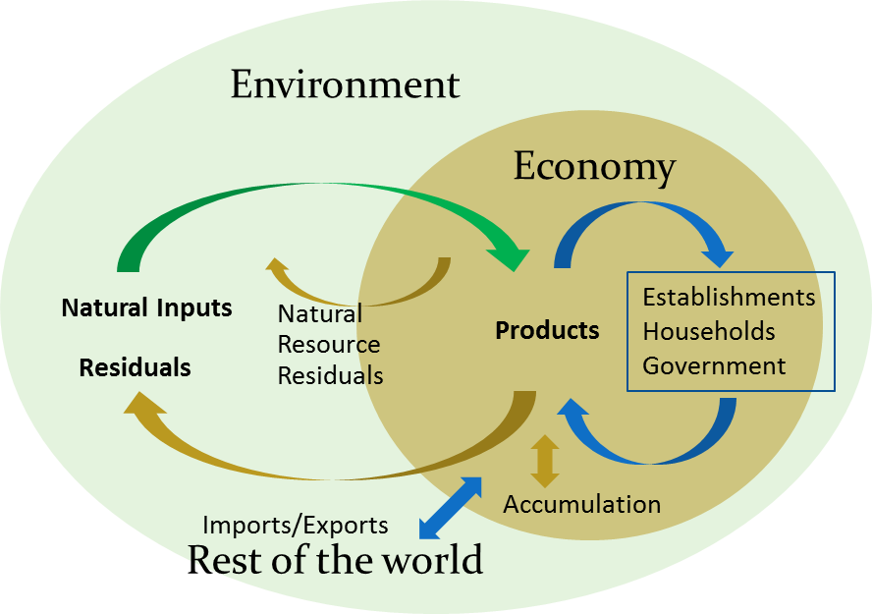
Accounting identities
2. Level 1
Input-output identity
Over an accounting period:
flows of materials into an economy
=
flows of materials out of an economy
+
any net additions to stock in the economy (accumulation)
Notes:
This emphasizes that the only way into an economy is natural inputs and imports. Some gets accumulated (in products, roads, buildings, landfill).
The rest goes back out as residuals or exports.

Slide 19
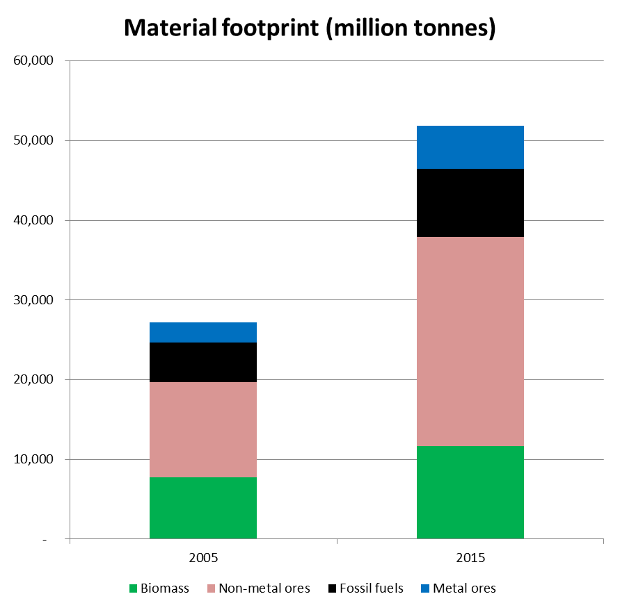
Accumulation can be big
2. Level 1
ESCAP
Both residuals and products can be accumulated
What are all the non-metal ores being used for?
Notes:
Answer: Construction materials to produce infrastructure.

Slide 20
Accounting identities
2. Level 1
Every entry to an account requires a corresponding and opposite entry to a different account
Supply and use identity (double entry accounting)
Total Supply (including imports) = Total Use (including exports)
Total Supply of | = Total Use of
Natural Resource Inputs (TSNI) | = Natural Resource Inputs (TUNI)
Products (TSP) | = Products (TUP)
Residuals (TSR) | = Residuals (TUR)
Double entry accounting:
Every entry to an account requires a corresponding and opposite entry to a different account

Slide 21
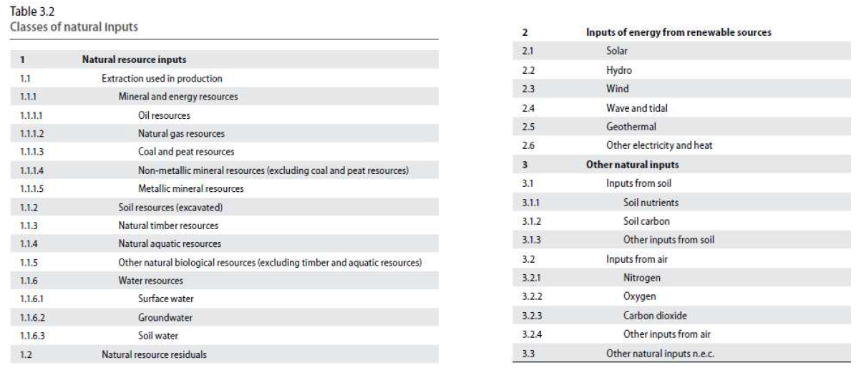
Definitions: Natural inputs
2. Level 1
3.45 … all physical inputs that are moved from their location in the environment as a part of economic production processes or are directly used in production.
?
Why no sea water?
Notes:
What are some Natural Inputs that are directly used? [solar, wind, soil nutrients…]
No sea water since not in “assets” (not a limiting resource), but should be there since is supplied to economy.

Slide 22
Definitions: Products
2. Level 1
3.64 …goods and services that result from a process of production in the economy (same as SNA)
CPC Ver. 2
(Central Product Classification)
0 – Agriculture, forestry and fishery products
1 – Ores and minerals; electricity, gas and water
2 – Food products, beverages and tobacco; textiles,
apparel and leather products
3 – Other transportable goods, except metal products,
machinery and equipment
4 – Metal products, machinery and equipment
5 – Constructions and construction services
6 – Distributive trade services; accommodation, food and
beverage serving services; transport services; and
electricity, gas and water distribution services
7 – Financial and related services; real estate services;
and rental and leasing services
8 – Business and production services
9 – Community, social and personal services
01 – Products of agriculture, horticulture and market gardening
02 – Live animals and animal products (excluding meat)
03 – Forestry and logging products
04 – Fish and other fishing products
21 – Meat, fish, fruit, vegetables, oils and fats
22 – Dairy products and egg products
23 – Grain mill products, starches and starch products; other food products
24 – Beverages
25 – Tobacco products
26 – Yarn and thread; woven and tufted textile fabrics
27 – Textile articles other than apparel
28 – Knitted or crocheted fabrics; wearing apparel
29 – Leather and leather products; footwear
Notes:
2 examples
Can find the full table in Annex

Slide 23
Definitions: Residuals
2. Level 1
2.92 … flows of solid, liquid and gaseous materials, and energy, that are
discarded, discharged or emitted by establishments and households
through processes of production, consumption or accumulation
Typical components for groups of residuals
Group | Typical components
Solid waste (includes recovered materials) | Chemical and health-care waste, metallic waste, animal and vegetal wastes, other recyclables
Wastewater* | Water for treatment and disposal, return flows, reused water
Emissions to air | Carbon dioxide, methane, ammonia, heavy metals, particulates
Emissions to water | Nitrogen compounds, phosphorus compounds, heavy metals
Emissions to soil | Leaks from pipelines, chemical spills
Residuals from dissipative use of products | Unabsorbed nutrients from fertilizers, salt spread on roads
Dissipative losses | Abrasion, erosion/corrosion of infrastructure
Natural resource residuals | Mining overburden, felling residues, discarded catch
Can you think of some energy residuals?
e.g. heat, light, sound…
* This list of typical components for groups of residuals can also be applied to certain flows defined as products
Notes:
Can you think of some energy residuals (heat, light, sound?)
Full table in the Annex

Slide 24
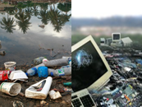
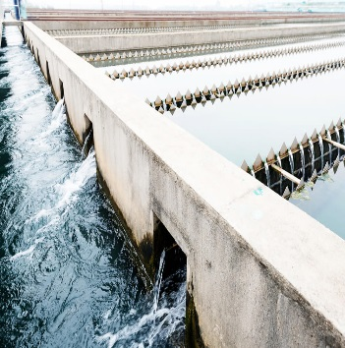
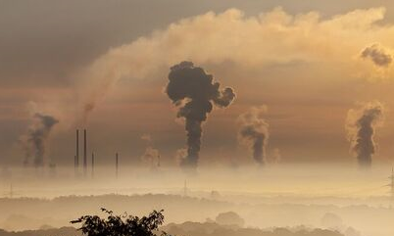
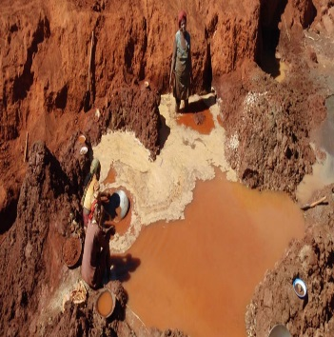
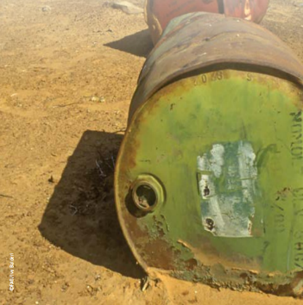

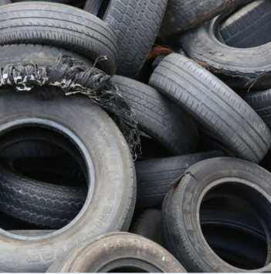
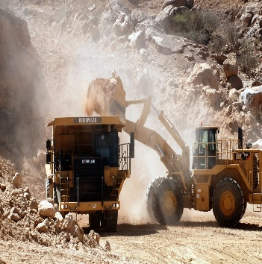
Definitions: Residuals
2. Level 1
2.92 … flows of solid, liquid and gaseous materials, and energy, that are
discarded, discharged or emitted by establishments and households
through processes of production, consumption or accumulation
Typical components for groups of residuals
Solid waste
(includes recovered materials)
Wastewater*
Emissions to air
Emissions to water
Can you think of some energy residuals?
e.g. heat, light, sound…
Emissions to soil
Residuals from dissipative use of products
Dissipative losses
Residuals from dissipative use of products
Notes:
Can you think of some energy residuals (heat, light, sound?)
* This list of typical components for groups of residuals can also be applied to certain flows defined as products
Full table in the Annex
<Pictures>
Solid waste: Chemical and health-care waste, metallic waste
Wastewater: Water disposal
Emissions to air:
Emissions to water: Artisanal small scale mining is responsible for up to 35% of global emission of mercury into the environment.
Emissions to soil: leaks from baried tanks
Residuals from dissipative use of products: Unabsorbed nutrients from fertilizers
Dissipative losses: Abrasion of tyres
Residuals from dissipative use of products: Mining overburden

Slide 25
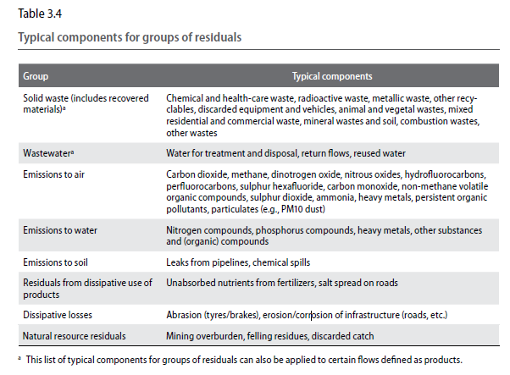
Definitions: Residuals
2. Level 1
2.92 … flows of solid, liquid and gaseous materials, and energy, that are
discarded, discharged or emitted by establishments and households
through processes of production, consumption or accumulation
Notes:
Can you think of some energy residuals (heat, light, sound?)

Slide 26
Compilation exercise
2. Level 1
Compile a physical supply and use table for oil resources:
Oil resources extracted by Mining (100 mln kg)
Mining supplies 100 mln kg crude oil to Refining
Refining produces 80 mln kg petrol
  Exports 50 mln kg petrol
  Supplies 30 mln kg petrol to Households (all is burned)
  Burns 20 mln kg crude oil for own consumption
Burning (combustion):
  Uses 3 units oxygen (O₂) per unit crude oil or petrol
  Creates 4 units of CO₂ per unit of crude oil or petrol

Slide 27
Complete the table
2. Level 1
How?
A. Follow the supply/use chain
B. Calculate column and row totals and check accounting identities (supply = use)
C. Burning 1 kg crude oil and petrol uses 3 kg O2 to create 4 kg CO2
D. Questions:
Total natural inputs?
Total products?
Total residuals?
Total materials?
1
3
5
2
4
6
The supply/use chain
Supplier User
1 Environment → 2 Mining
3 Mining & imports → 4 Refining
5 Refining → 6 Households & Exports

Slide 28
Answers
2. Level 1
Total natural inputs = 250
Total products = 180
Total residuals = 200
Total materials = 630
* Unit: mln kg
Notes:
Note: Total use/supply (natural inputs, products, residuals) more for checking than analytical.
Monetary would be tracking value added.

Slide 29
Answers: Why?
2. Level 1
Data sources:
Corporate reports
Agencies: Mining
Taxes, concessions
Environment supplies 100 mln kg oil resources to Mining

Slide 30
Answers: Why?
2. Level 1
Data sources:
Corporate reports
Agencies: Energy, Customs
Taxes, surveys ($$$)
Mining supplies 100 mln kg crude oil to Refining
Refining consumes 20 mln kg crude oil

Slide 31
Answers: Why?
2. Level 1
Data sources:
Household, business surveys
Agencies: Transport, Customs Retail trade
Refining supplies 30 mln kg petrol to Households
and 50 mln kg to Exports

Slide 32
Answers: Why?
2. Level 1
Data sources:
Calculated
Refining burns 20 mln kg crude oil, environment supplies 60 mln kg O2 to supply 80 mln kg CO2
Households burn 30 mln kg petrol, environment supplies 90 mln kg O2 to supply 120 mln kg CO2
200 mln kg CO2 are used by the environment

Slide 33
Welcome to Level 2!
3. Level 2
A few more concepts
  Types of natural resource residuals
  Is it a product or a residual?
  Transboundary flows
  How to account for losses
Data sources
Compilation challenges
Discussion on country priorities

Slide 34
Concepts
3. Level 2
Types of natural resource residuals
  Natural resource inputs that doesn’t become products and instead immediately return to the environment
Losses during extraction
Resources the extractor would prefer to retain.
Example: Losses of natural gas through flaring and venting
Resources in which the extractor has no ongoing interest.
Example: Mining overburden; mine de-watering; discarded fish catch
Reinjections
Unused extraction
Natural resources extracted but immediately returned to the deposit and may be re-extracted at a later time.
Example: Water injected into aquifer; natural gas reinjection

Slide 35




Concepts
3. Level 2
Product or residual?
  If payment made = product
  Example: recycled materials
    Home:
      Newspapers = solid waste → recycling, garbage
        Recycling industry: recovered → product
        Waste management industry → landfill
    Business
      Newspapers → recycling (product)
        Recycling industry → product
What is the difference between product and residual?
product
Treated as a transaction in a product, not as a residual
discarder
receiver
money / benefits
Notes:
Good example?

Slide 36
Concepts
3. Level 2
Transboundary flows of residuals
  Only products are imported and exported (includes solid waste “products” such as scrap metal)
    In waste management, we can import residuals as well
  Residuals (e.g. wastewater, air emissions, solid wastes) flow within the environment
    It can be recovered from the environment
Water asset accounts do track inflows & outflows
Notes:
Why? Never certain about quantities & directions of transboundary.

Slide 37
Concepts
3. Level 2
“Losses” are residuals the supplier
would prefer to retain
Losses during extraction
…occur during extraction before processing, treatment and transportation of the extracted resource…
…between abstraction, extraction or supply and point of use…
Losses during storage
Losses during distribution
…energy products and materials…
Losses during transformation
…heat and energy, during the transformation of one energy product into another energy product…

Slide 38
Data sources
3. Level 2
Industry & household surveys
- inputs/outputs of materials, energy, water, residuals
- Government/private waste management
- imports, exports, consumption
- Pollutant release and transfer register
Field measurement
Administrative & regulatory data
- waste, water, energy, material audits
- Engineering design factors (estimate losses)
Existing statistics
- National accounts ($supply/use to estimate physical)
- Energy balances
- Company reports
Notes:
Survey of Industrial Processes (need an engineer)
Rapid Assessment Method

Slide 39
Data sources
3. Level 2
Industry & household surveys
  Inputs/outputs of materials, energy, water, residuals
  Government/private waste management
Administrative & regulatory data
  Imports, exports, consumption
  Pollutant release and transfer register
Field measurement
  Waste, water, energy, materials audits
  Engineering design factors (estimate losses…)
Existing statistics
  National Accounts ($ supply/use to estimate physical)
  Energy balances
  Company reports
Notes:
Survey of Industrial Processes (need an engineer)
Rapid Assessment Method

Slide 40
Compilation challenges
3. Level 2
Correcting for residence principle
  Tourists, foreign airplanes ≠ consumers
Disaggregating & linking information to ISIC
  Details, details, details (material type…)
  Data may be on “activity” (fuel used for transport)
  Household “sector” engaged in productive activity
Consistency with National Accounts concepts
  Within enterprise flows in SEEA (not in SNA)
Compiling time series
  Sources and detail change over time
  (e.g., industry surveys include quantities or $ value)
  Prices change over time (price × volume = value)
Remember example: Refining consumes crude oil.
Notes:
Residence principle: economic units with a centre of interest in the economic territory.

Slide 41

Documentation challenges
3. Level 2
There are some inconsistencies between SEEA-CF and SEEA-Water
  SEEA-Water is based on SEEA-2003
  e.g., “Supply” / “Use”
  e.g., “Consumption” = “Use”
  Extraction/abstraction = Supply
SEEA-Energy is based on SEEA-CF 2012
Suggest using SEEA-CF (2012) as the primary guidance and sub-components for details

Slide 42
Discussion
3. Level 2
Which physical flow accounts could be a priority in your country?
  Materials, Water, Energy
  Solid Wastes, Air emissions, Wastewater
What sources of data do you have?
What are the gaps?
What would be the next steps:
  New data?
  Collaborate with data sources? Stakeholders? Funding?
  Learn how to create accounts?

Slide 43
References
References
SEEA-CF: http://unstats.un.org/unsd/envaccounting/seeaRev/SEEA_CF_Final_en.pdf
SEEA-Energy: http://unstats.un.org/unsd/envaccounting/seeae/chapterList.asp
SEEA-Water: http://unstats.un.org/unsd/envaccounting/seeaw/seeawaterwebversion.pdf
SEEA-Agriculture, Forestry and Fisheries: http://unstats.un.org/unsd/envaccounting/aff/2GC_Draft.pdf
OECD PRTR (Pollutant release and transfer registry): http://www.oecd.org/chemicalsafety/pollutant-release-transfer-register/
UNEP: Indicators for a Resource Efficient and Green Asia and the Pacific: Toolkit Page http://www.unep.org/roap/Activities/ResourceEfficiency/IndicatorsforaResourceEfficient/tabid/1060186/Default.aspx

Slide 44
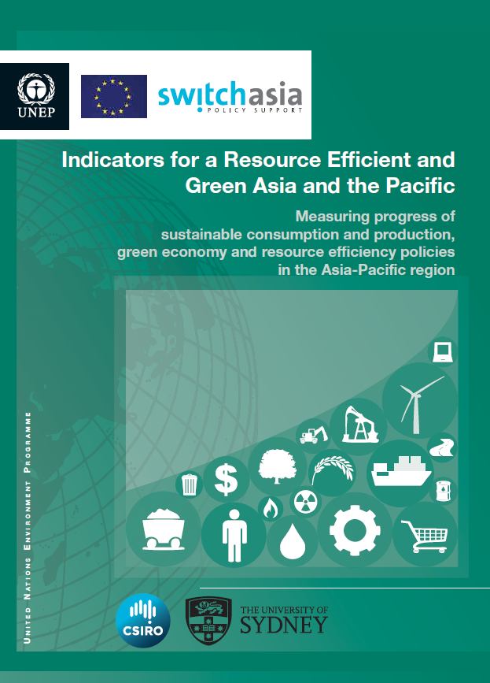
Data sources
UN Environment: Indicators for a Resource Efficient and Green Asia and the
Pacific: Toolkit Page
National and international sources
Visualize data
Download data
http://web.unep.org/asiapacific/regional-initiatives/resource-efficiency

Slide 45
Acknowledgements
Acknowledgements
Materials prepared by:
  Michael Bordt
    Regional Adviser on Environment Statistics
    ESCAP Statistics Division
    bordt@un.org
  Hye Kyeong Choi
    Consultant on Environment Statistics
    ESCAP Statistics Division
    gracechoi0102@gmail.com
Materials adapted from:
  Joe St. Lawrence (Statistics Canada; Chiba, Japan; Feb. 23, 2016)
  Julian Chow (UNSD; Malaysia; Sept. 23, 2013)
  Ole Gravgård (Statistics Denmark; Addis Ababa, Ethiopia; Feb. 2, 2015)

Slide 46
Annex
Annex
CPC (Central Product Classification) ver 2.

Slide 47
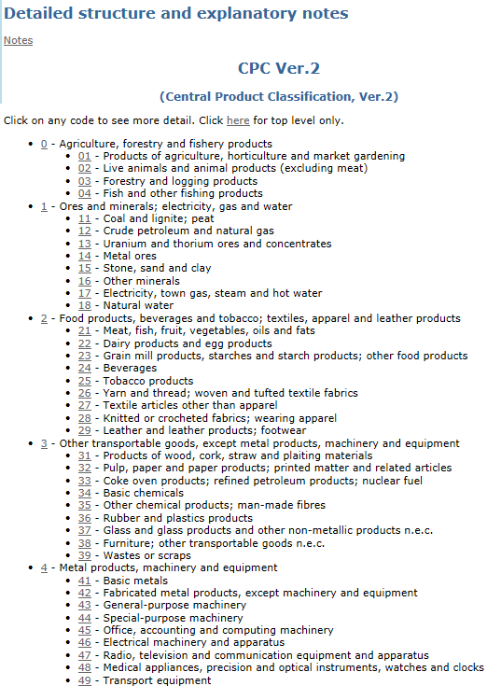
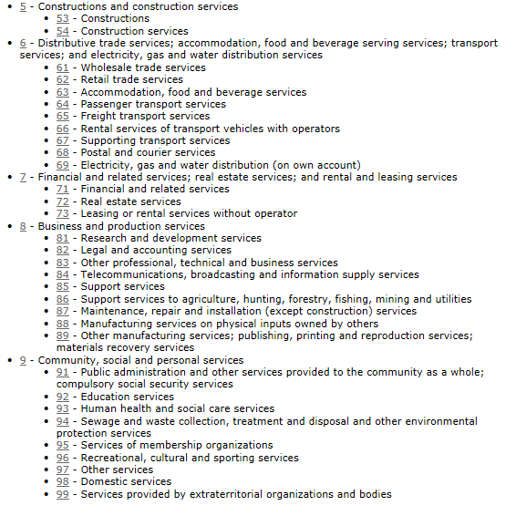
Definitions: Products
Annex
3.64 …goods and services that result from a process of production in the economy (same as SNA)

