Slide 1
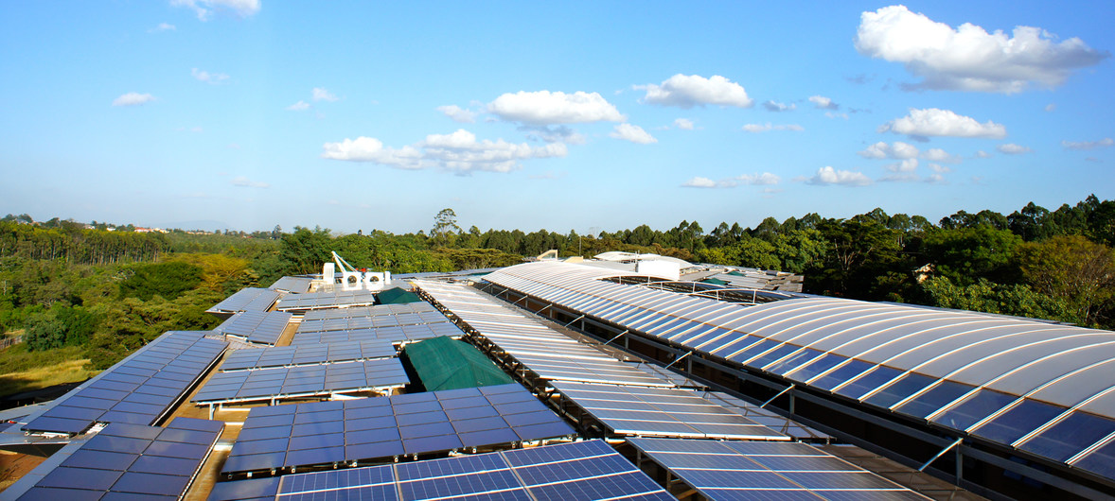

Overview of Energy Flow Accounts
Notes:
Note that some of the participants may know more about energy accounting than the presenter. However, this introduction is very helpful to ensure everyone has the same basic knowledge.
RIKKE: Ask participants: who knows about [experience in producing or using]:
Energy statistics
Energy balances
Energy accounts

Slide 2
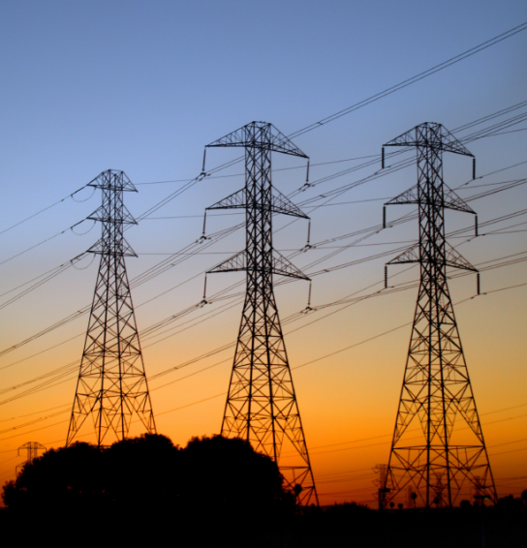


Outline
Outline
1. Learning Objectives
2. Level 1: What are energy flow accounts? (30min)
  Links to other SEEA accounts
  Links to SDGs
Group exercise (30min)
3. Intermezzo: Linking energy balances and energy accounts (15min)
4. Level 2: Issues, data sources, country examples (20min)
Questions and discussion (10min)

Slide 3
Learning objectives
1. Learning Objectives
Know what Energy Flow Accounts are and why they are important
Understand the basic concepts and how they are treated in the SEEA
Learn to compile Energy Flow Accounts
Understand how Energy Flow Accounts are linked with Energy Balances and be aware of main differences
Be aware of data sources, country examples and measurement challenges
Notes:
This is a “teaser” – we will not get into the many intricacies – but you should by the end be able to compile a rudimentary energy account, understand the principles behind, and be aware of what it would involve to do “full” energy accounting in the “real” world

Slide 4
Environment accounts and statistics
2. Level 1
SEEA-CF (Central Framework) | Assets Physical flows Monetary flows | Minerals & Energy, Land, Timber, Soil, Water, Aquatic, Other Biological Materials, Energy, Water, Emissions, Effluents, Wastes Protection expenditures, taxes & subsidies
SEEA Water; SEEA Energy; SEEA Agriculture, Forestry and Fisheries | Add sector detail | As above for Water Energy Agricultural, Forestry and Fisheries
SEEA-EEA (Experimental Ecosystem Accounting) | Adds spatial detail and ecosystem perspective | Extent, Condition, Ecosystem Services, Carbon, Water, Biodiversity
FDES (Framework for the Development of Environment Statistics) | Basic statistics for above plus… | Extreme events and disasters Human settlements and health Protection, management & engagement
Notes:
1 & 2: Energy is an asset that we track as part of Mineral and Energy Asset Accounts. Timber assets are tracked separately.
3 & 4: We can track the flows of energy into the economy, flows within the economy and the resulting emissions out of the economy. And this is what we will focus on today
5. We can track expenditures on energy efficiency, resource management, taxes and subsidies.
6. There is a more detailed “SEEA-Energy”
7. Energy in terms of biomass, timber and hydro is also an ecosystem service we can integrate with others.

Slide 5
Environment accounts and statistics
Outline
SEEA-CF (Central Framework) | Assets Physical flows Monetary flows | Minerals & Energy, Land, Timber, Soil, Water, Aquatic, Other Biological Materials, Energy, Water, Emissions, Effluents, Wastes Protection expenditures, taxes & subsidies
SEEA Water; SEEA Energy; SEEA Agriculture, Forestry and Fisheries | Add sector detail | As above for Water Energy Agricultural, Forestry and Fisheries
SEEA-EEA (Experimental Ecosystem Accounting) | Adds spatial detail and ecosystem perspective | Extent, Condition, Ecosystem Services, Carbon, Water, Biodiversity
FDES (Framework for the Development of Environment Statistics) | Basic statistics for above plus… | Extreme events and disasters Human settlements and health Protection, management & engagement
Notes:
1 & 2: Energy is an asset that we track as part of Mineral and Energy Asset Accounts. Timber assets are tracked separately.
3 & 4: We can track the flows of energy into the economy, flows within the economy and the resulting emissions out of the economy. And this is what we will focus on today
5. We can track expenditures on energy efficiency, resource management, taxes and subsidies.
6. There is a more detailed “SEEA-Energy”
7. Energy in terms of biomass, timber and hydro is also an ecosystem service we can integrate with others.

Slide 6
Scope of energy flow accounts
2. Level 1
SEEA-CF 3.140…record flows of energy, in physical units,
  from the initial extraction or capture of energy resources from the environment into the economy;
  the flows of energy within the economy in the form of the supply and use of energy by industries and households; and, finally,
  the flows of energy back to the environment.
  Follows the general physical flow framework
Notes:
Today we will focus on the Energy Flow Accounts
Also known as Physical Supply and Use Tables for Energy.

Slide 7
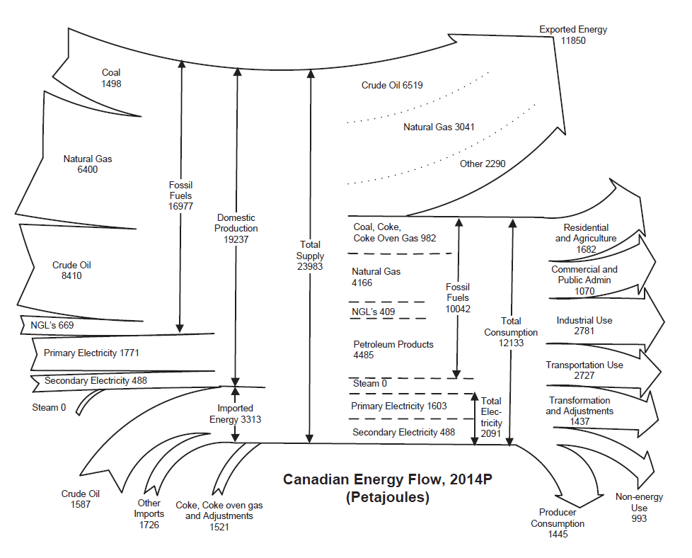
Energy flows
2. Level 1
Statistics Canada. (2016). Report on Energy Supply and Demand in Canada 2014 Preliminary. Catalogue no. 57-003-X.
Notes:
The energy flow chart provides a snapshot overview of the energy sector – in terms of physical flows
Energy is extracted, harvested, captured and imported
It is transformed, lost and used (including for non-energy products)
Note that much energy is converted from primary to secondary energy products – a concept that is important to understand for energy account compilation/concept
Example: Crude oil transforms [from left to right]

Slide 8
Which are energy flows?
2. Level 1
☒
Carbon emissions from fossil fuel combustion
Cutting trees for fuel wood
Heating/cooling a home
Installing solar panels
Driving a car
Buying mercury-free batteries
Generating electricity from wind turbine
Oil and gas reserves
Fuel tax
☑
☑
☒
☑
?
☑
☒
☒
Notes:
Carbon emissions can be estimated from some energy flows (fossil fuels).
Cutting trees = harvesting (supply)
Heating/cooling = use
Installing solar panels = infrastructure
Driving a car = use
? Buying batteries (not included in SIEC)
Generating = supply
Reserves = stock
Fuel tax = expenditure on controlling/managing

Slide 9







Uses of energy flows
2. Level 1
Implied in a number of SDGs
  Accessible? Clean?
  Sustainable?
  Efficient?
Trade-offs between goals?
Integrated view of energy policy
A critical look at energy statistics
Notes:
The SDGs inject a “holistic” view of the energy sector – linking it to the environment [RE target; CC SDG], the economy [SDG 8] and the people [ACCESS target; reliance on dirty fuels/inefficient technology for cooking target]
Also:
Promote investment in energy infrastructure and clean energy technology
Part of “strong economic foundation”
Can you think of a trade-off between energy and other SDGs?
food, water, climate…

Slide 10
Some principles
2. Level 1
Physical units (Joules; abbreviated “J”)
  A “joule” is a unit of energy;
  10⁹ J = gigajoule; 10¹² J = terajoule; 10¹⁵ = petajoule (PJ)…
  Also used: ToE (Tons of Oil Equivalent) = 4.19 10⁷ J
  1 kWh (kilowatt hour) = 3.6 10⁶ J
  There are conversion tables…
Supply = Use
Household production is part of the industry
Notes:
Energy flow accounts are all measured in the same physical units. SEEA suggests joules.
To align with the SNA, the SEEA applies the residence principle.
Ask audience what “residence principle” means. The energy balance applies the territorial principle. And mention that for some big energy consumers, this makes a huge difference [“bunkers” for shipping, ie storage abroad]
Energy flow accounts also includes energy generated for own use consumption. For example, if a forestry firm burns wood for heat, this is counted.
And if a household generates power from solar panels on their roof, this [including their own consumption] is included [under “industry”, by the way]. And this is the same for energy balances, by the way. For the wood/heat example, in energy balances, only the heat sold [and corresponding wood] would be counted.
There is a difference between accounts and balances in the definition of “final consumption”. In the SNA final “demand” is allocated to personal expenditure, exports, government, machinery and equipment and inventories (i.e., the things people buy, and what we export). Hence, industry use of energy products is considered “intermediate” consumption.
In an energy balance, the use of an energy product (not for conversion) is considered final consumption – whether by industry or household
We will get more details on linkages and differences between balances and accounts in the “intermezzo” session

Slide 11
Some definitions
2. Level 1
Energy inputs from the environment
Conventional solid and liquid resources extracted and harvested
Renewable resources captured
Embedded in cultivated biomass harvested
Notes:
All energy is supplied by the environment. It is extracted, harvested and captured.

Slide 12
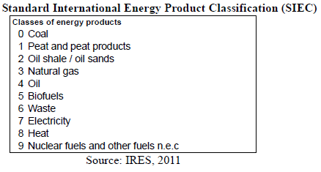
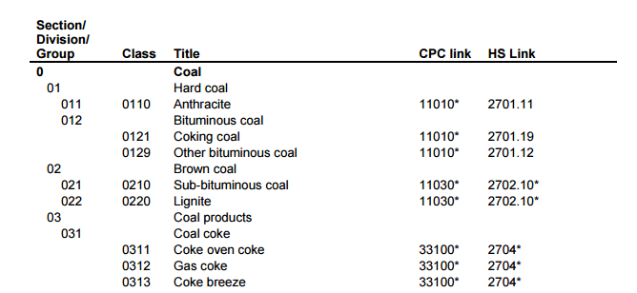
Some definitions
2. Level 1
Energy products
Products that are used, or might be used, as a source of energy
Standard International Energy Product Classification (SIEC)
  Countries may use others (CPC, HS)
Useful to distinguish
  Primary/secondary
  Energy/non-energy uses
Heat and electricity
- Primary or secondary?
Heat and electricity can be either primary or secondary products depending on the process of their production.
Notes:
Natural inputs are used directly or transformed to energy (and non-energy) products.
Primary energy products: produced directly from the extraction or capture of energy resources from the environment
Secondary energy products: result of transformation of primary, or other secondary, energy products into other types of energy products (e.g petroleum products from crude oil, charcoal from fuelwood, electricity from fuel oil)
The SIEC contains much detail.
Nevertheless, your starting point may be the Central Product Classification or the Harmonized System; don’t despair because of that

Slide 13
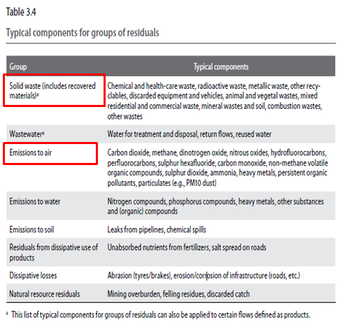
Some definitions
2. Level 1
Energy Residuals
Losses during
  Extraction
  Distribution
  Storage
  Transformation
Other energy residuals
  Releases to the environment (lost heat) from energy consumption
  This is a separate line that is the sum of all consumption
Note: Some non-energy residuals (emissions to air, CO₂, solid waste) can be calculated from energy accounts.
Notes:
Energy residuals (not air emissions or solid wastes) are generally losses (including heat from final consumption).

Slide 14
The supply-use chain
2. Level 1
Notes:
This is similar for all Physical Supply and Use Tables (Energy, materials, water, solid waste…); Who supplies them? Who uses them?
1. Energy inputs are extracted, harvested or captured from the environment (supplier) by the relevant industries (users).
2. These industries, in turn, become the suppliers of energy products.
3. Together with imports, energy products are used (for transformation or directly) by industries, households, accumulation, and exports
4. In consuming energy, residuals (losses of energy products, heat) are supplied
5. Some of which are collected and treated, accumulated, exported or released to the environment.

Slide 15
Classifications
2. Level 1
Industries
SEEA based on International Standard
Industrial Classification (ISIC)
Countries may use others
Significant energy industries
Section A: Agriculture, forestry and fishing
Section B: Mining and quarrying
Section C: Manufacturing
Section D: Electricity, gas, steam and air conditioning supply
Section H: Transportation and storage
Other industries
Households
Notes:
It is useful to provide detail on certain industries that extract, harvest, capture, transform and use energy.
Which industries are major producers, transformers or users of energy?

Slide 16
Group exercise
2. Level 1
Situation:
  Have information on energy supply and use
  Compile basic supply and use tables
Groups of 3-5 (not alone!)
  Put data into correct cells in handouts
  Check totals
Report on
  Total supply of energy from natural inputs
  Total energy supply
  Total use of energy residuals
  Total energy use
Notes:
If more groups, could add more questions to report on.

Slide 17
Group Exercise
2. Level 1
A simplified physical supply and use table for energy:
The mining industry extracts 150 PJ of coal.
In total, 60 PJ of electricity are generated from solar panels,
  50 PJ of which are produced by solar power industry and the rest by households.
All the coal is sent for processing to the coal power plant.
  However, due to losses during extraction, the coal power plant received 140PJ of coal.
The remaining supply of coal is converted to electricity and heat.
  The coal power plant produces 75 PJ of electricity and 35 PJ of heat.
  Losses during transformation account for the rest of the coal supply.
The resulting electricity from solar and coal is used as follows:
  Mining 15 PJ, manufacturing 20PJ, Electricity 32 PJ and with households consuming the rest of the electricity.
Households use 26PJ of heat, electricity sector uses 2 PJ and the rest is used by mining.
When household generates energy, it is considered as part of the industry.
Notes:
You need to do some calculations, but this is mostly putting the numbers in the right cells in the table.

Slide 18
Group exercise – the answers
2. Level 1
Total supply of energy from natural inputs (210 PJ)
Total energy supply (730 PJ)
Total use of energy residuals (210 PJ)
Total energy use (730 PJ)

Slide 19
Group exercise – the answers
2. Level 1
The mining industry extracts 150 PJ of coal.
In total, 60 PJ of electricity are generated from solar panels,
  50 PJ of which are produced by solar power industry and the rest by households.
Household solar generation is in electricity industry
All the coal is sent for processing to the coal power plant.
  However, due to losses during extraction, the coal power plant received 140PJ of coal.
Notes:
How do we get this?

Slide 20
Group exercise – the answers
2. Level 1
The remaining supply of coal is converted to electricity and heat.
  The coal power plant produces 75 PJ of electricity and 35 PJ of heat.
  Losses during transformation account for the rest of the coal supply. (140 – 35 – 75 = 30)
Total electricity supply (135 PJ)
= 75 PJ form coal + 60 PJ from solar
The resulting electricity from solar and coal is used as follows:
  Mining 15 PJ
  Manufacturing 20PJ
  Electricity 32 PJ and with
  Households consuming the rest of the electricity. (68 PJ)
75+60
Notes:
Total electricity supply is 75PJ from coal, 60PJ from solar.

Slide 21
Group exercise – the answers
2. Level 1
Households use 26PJ of heat, electricity sector uses 2 PJ and the rest (7PJ) is used by mining.
“Other” residual is total end use
Check:
Total supply of natural inputs
= total use of natural inputs
Total supply of energy products = total use of energy products
Total supply of energy residuals
= total use of energy residuals
Bonus question: What energy product is double-counted and why?
Notes:
Bonus question: Coal is counted twice (as coal [140PJ] and as electricity [75PJ] + heat [35PJ] = 110PJ)

Slide 22
Intermezzo …..
3. Intermezzo
Linking energy balances and energy accounts
Notes:
Many of you may already produce energy balances – this is a great starting point for producing physical energy accounts

Slide 23
Territory vs Residence principle
2. Review of basics
 | Residents | Non-residents
National territory | Sold on territory to resident units | Sold on territory to non-residents (foreign, tourists, transport companies, embassies)
Rest of the world | Sold to residents operating abroad (tourists, transport, companies etc.)
Energy Statistics
Energy Balances
SEEA-Energy
Notes:
SEEA Energy, Section 2.2.2

Slide 24
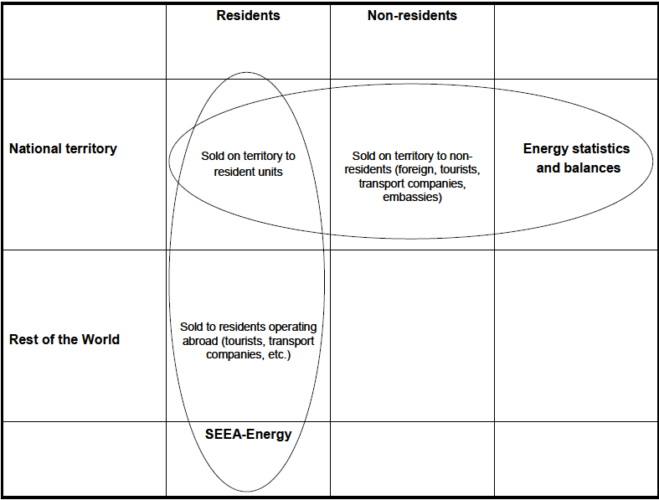
Territory vs Residence principle
3. Intermezzo
Notes:
SEEA Energy, Section 2.2.2

Slide 25
Residence principle
3. Intermezzo
Residents of country regardless of location (e.g., energy products sold to residents)
Exclude energy products sold to (or owned by) non-residence
In principle…
Notes:
Energy flow accounts are all measured in the same physical units. SEEA suggests joules.
To align with the SNA, the SEEA applies the residence principle.
Ask audience what “residence principle” means. The energy balance applies the territorial principle. And mention that for some big energy consumers, this makes a huge difference [“bunkers” for shipping, ie storage abroad]
Energy flow accounts also includes energy generated for own use consumption. For example, if a forestry firm burns wood for heat, this is counted.
And if a household generates power from solar panels on their roof, this [including their own consumption] is included [under “industry”, by the way]. And this is the same for energy balances, by the way. For the wood/heat example, in energy balances, only the heat sold [and corresponding wood] would be counted.
There is a difference between accounts and balances in the definition of “final consumption”. In the SNA final “demand” is allocated to personal expenditure, exports, government, machinery and equipment and inventories (i.e., the things people buy, and what we export). Hence, industry use of energy products is considered “intermediate” consumption.
In an energy balance, the use of an energy product (not for conversion) is considered final consumption – whether by industry or household
We will get more details on linkages and differences between balances and accounts in the “intermezzo” session

Slide 26
An Overview
3. Intermezzo
Energy Balances
Various formats (IEA, Eurostat, UN)
Sectors and industries (ISIC)
Territory principle
Based on energy statistics
Supply and use balances
Physical data
Based on energy balances
Uses national accounts SUT format
Industries classified by ISIC
Resident principle
Monetary data
Based on primary statistics
Specific energy surveys
No specific format
Energy Statistics
Energy Accounts
Notes:
Need note on what statistics, balances and accounts are good for and why they can co-exist:
Energy statistics (e.g., IRES): common concepts, units, classifications, conversion factors; social dimension (e.g., distribution and household expenditures on energy)
Energy balances: purpose/activity of use (e.g., transport); link to IPCC/territorial; net consumption?
Energy accounts: link to SNA/residential (all residents regardless of location); efficiency measures; calculate air emissions; includes own-generation
Energy policy concerns: availability, distribution (equity), supply/security, economic benefits/sustainability; emissions/renewables; hazards/spills

Slide 27
An Overview
3. Intermezzo
Energy Balances
Various formats (IEA, Eurostat, UN)
Sectors and industries (ISIC)
Territory principle
Physical data
Based on energy statistics
Supply and use balances
Based on energy balances
Uses national accounts SUT format
Industries classified by ISIC
Resident principle
Physical and Monetary data
Based on primary statistics
Specific energy surveys
No specific format
Energy Statistics
Energy Accounts
Notes:
Need note on what statistics, balances and accounts are good for and why they can co-exist:
Energy statistics (e.g., IRES): common concepts, units, classifications, conversion factors; social dimension (e.g., distribution and household expenditures on energy)
Energy balances: purpose/activity of use (e.g., transport); link to IPCC/territorial; net consumption?
Energy accounts: link to SNA/residential (all residents regardless of location); efficiency measures; calculate air emissions; includes own-generation
Energy policy concerns: availability, distribution (equity), supply/security, economic benefits/sustainability; emissions/renewables; hazards/spills

Slide 28
Creating balances and accounts
3. Intermezzo
Use the same data
  Many flows are identical in balances and accounts
Important differences
  Terminology
  Territory vs residence principle
  Treatment of transport
Note: Purpose of accounts is comprehensiveness and consistency with SNA
Balances
Accounts
Energy statistics
Natural Inputs, imports, transformation, supply, use, residuals
Combined data sources: admin, surveys, SNA, models
Notes:
What would be some of the challenges in maintaining a common, detailed database?
Sharing
Confidentiality
Concepts, classifications, definitions
Treatment of transport: whether we are tracking an activity or an industry sector

Slide 29
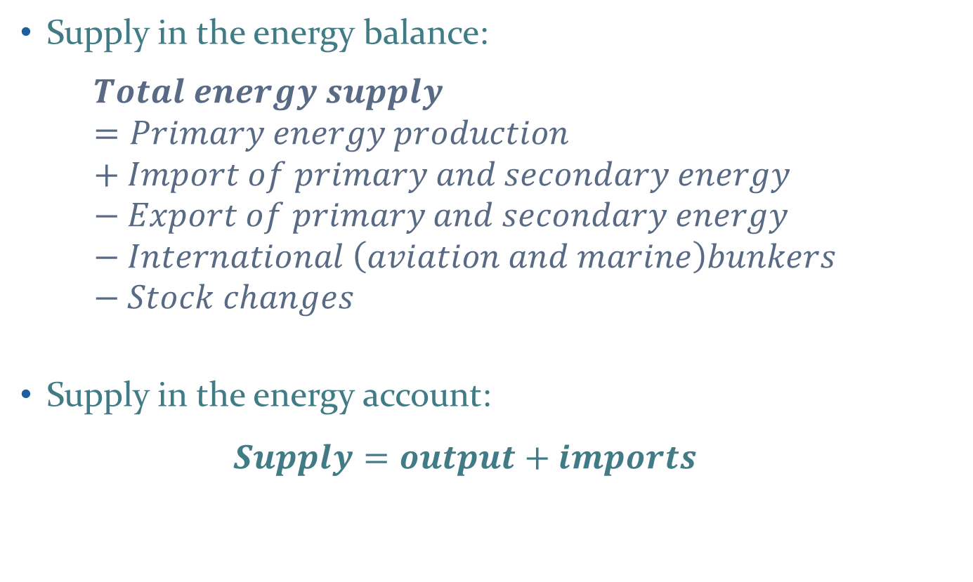
Terminology: Energy supply
3. Intermezzo
Supply in the energy balance:
  $$Total energy supply=Primary energy production+Import of primary and secondary energy−Export of primary and secondary energy−International \left(aviation and marine\right)bunkers−Stock changes$$
Supply in the energy account:
$$Supply=output+imports$$
Notes:
SEEA Energy Section 3.4.5.

Slide 30
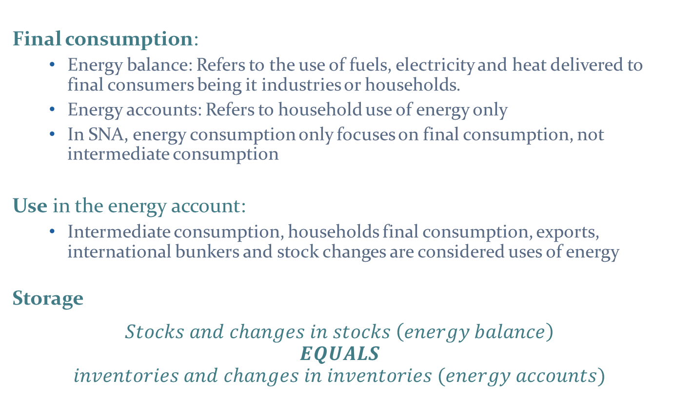
Terminology: Energy use and storage
3. Intermezzo
Final consumption:
  Energy balance: Refers to the use of fuels, electricity and heat delivered to final consumers being it industries or households.
  Energy accounts: Refers to household use of energy only
  In SNA, energy consumption only focuses on final consumption, not intermediate consumption
Use in the energy account:
  Intermediate consumption, households final consumption, exports, international bunkers and stock changes are considered uses of energy
Storage
$$Stocks and changes in stocks \left(energy balance\right)$$
$$EQUALS$$
$$inventories and changes in inventories (energy accounts)$$
Notes:
SEEA Energy Section 3.4.5.

Slide 31
Actual difference
– territory vs. residence principle
3. Intermezzo
Total emissions originating from the Danish territory (IPCC-emission inventory) | 54,568
+ Emissions caused by Danish operated vehicles abroad | 1,905
+ Emissions caused by Danish operated planes abroad | 1,105
+ Emissions caused by Danish operated ships abroad | 35,084
+ Other differences in emissions from transport and cross border trade | 612
= Total Emissions from Danish economic activities (Environmental Accounts) | 93,274
Territorial Emissions
+
Residence
principle
II
Residential Emissions
An extreme case, but still …..
Notes:
Note: The residence principle increases emissions estimates by 70% (much is A.P. Moller-Maersk Group the world’s largest transport company that operates mostly outside of Denmark.)
Total emissions originating from the Danish territory (energy balance) + residence principle = Total emissions. Therefore, the residence principle increases emission.

Slide 32
Actual difference
– territory vs. residence principle
3. Intermezzo
Total emissions originating from the Danish territory (IPCC-emission inventory) | 54,568
+ Emissions caused by Danish operated vehicles abroad | 1,905
+ Emissions caused by Danish operated planes abroad | 1,105
+ Emissions caused by Danish operated ships abroad | 35,084
+ Other differences in emissions from transport and cross border trade | 612
= Total Emissions from Danish economic activities (Environmental Accounts) | 93,274
An extreme case, but still …..
Notes:
Note: The residence principle increases emissions estimates by 70% (much is A.P. Moller-Maersk Group the world’s largest transport company that operates mostly outside of Denmark.)
Total emissions originating from the Danish territory (energy balance) + residence principle = Total emissions. Therefore, the residence principle increases emission.

Slide 33
3. Intermezzo
Tools to ease the conversion
Working group led by UNSD (with IEA, Eurostat, OECD + experts)
  Will provide assessment of existing sources; and roadmap
  Applies to countries not currently filling the detailed IEA energy statistics questionnaires (see PEFA Builder)
  Have prototype spreadsheet for testing (seea@un.org)

Slide 34








EuroStat
– Physical Energy Flow Accounts (PEFA) Builder
3. Intermezzo
Application to record flows of energy from the environment (natural inputs), within the economy (products), and back to the environment (residuals)
Starts with energy statistics
Calculates energy residuals
+
Bridge table for residence/territorial conversion
Notes:
I’m not sure how to get access to PEFA Builder. S. Korea tried it and it didn’t work, but now they figured it out. We should understand it better if we are going to promote it.

Slide 35
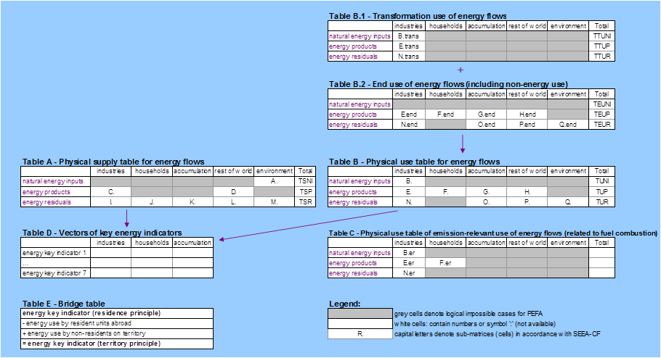
EuroStat
– Physical Energy Flow Accounts (PEFA) Builder
3. Intermezzo
Application to record flows of energy from the environment (natural inputs), within the economy (products), and back to the environment (residuals)
Starts with energy statistics
Calculates energy residuals
Bridge table for residence/territorial conversion
Notes:
I’m not sure how to get access to PEFA Builder. S. Korea tried it and it didn’t work, but now they figured it out. We should understand it better if we are going to promote it.

Slide 36
Level 2
4. Level 2
Issues
Data sources
Country examples
Questions and discusstion
Notes:
In Level 2, we will explore some further concepts and country examples.

Slide 37
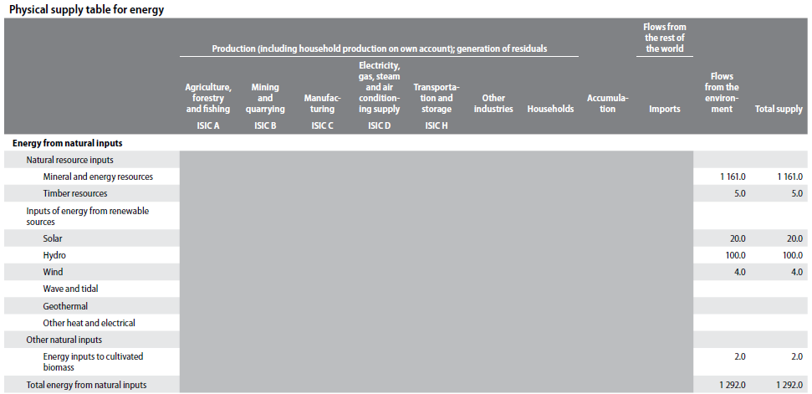
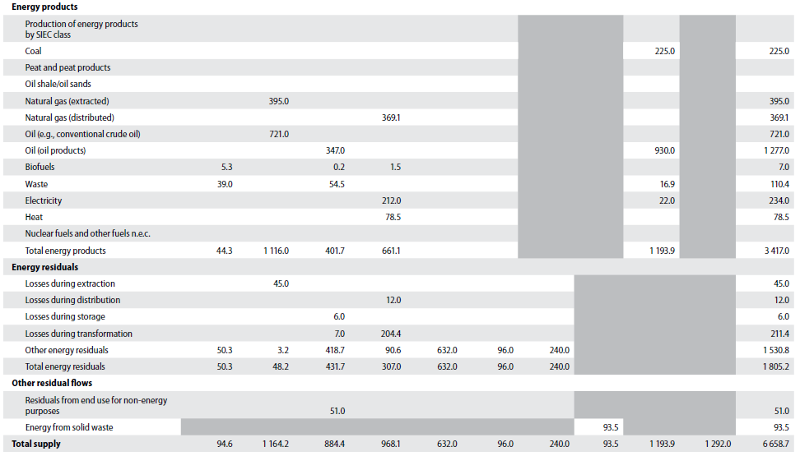
Energy supply in the SEEA
4. Level 2
Energy from natural inputs
Energy products
Residuals &
other flows
Notes:
Difference between SEEA-CF and the example used for the earlier exercise:
More types of energy, more disaggregated (example didn’t cover consumption of oil, petrol/gasoline, e.g., by transportation)
Imports and exports
Non-energy products
More transformations

Slide 38
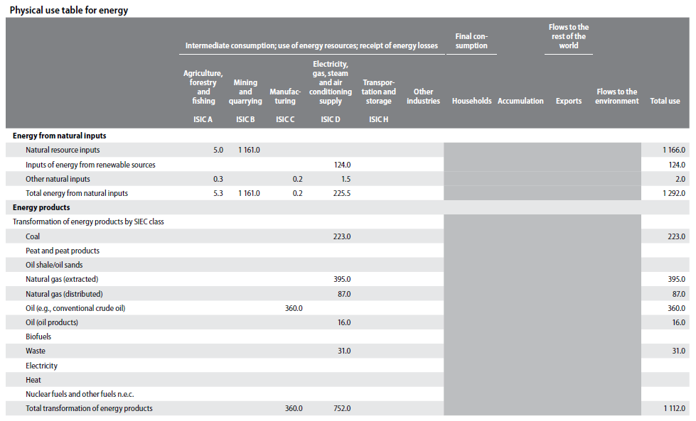
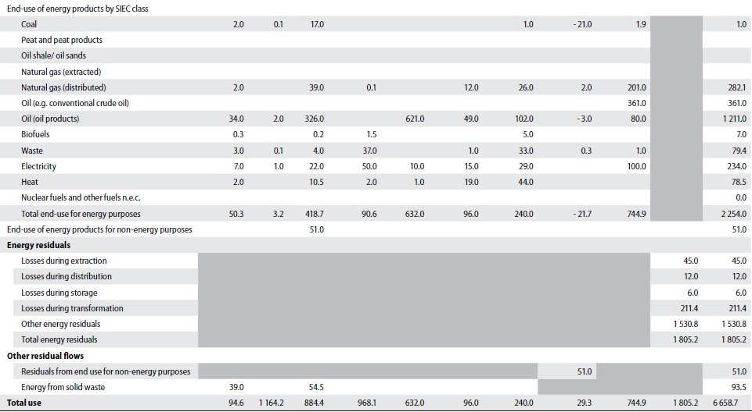
Energy use in the SEEA
4. Level 2
Energy from natural inputs
Energy products
Transformation & End-use
Residuals &
other flows

Slide 39
Compilation challenges & data
4. Level 2
Getting data in detail (energy balances help)
  ISIC and SIEC
Bridge tables to convert from balance to account
  Balance may be by “purpose” (e.g., transport)
Getting data from importers/distributers
  May be easier for NSOs than Energy/Environment (if for statistical purposes!)
Allocating to natural inputs, products, residuals
  “Mixed” producers (e.g. co-production of electricity and district heating; coal mines own power generation)
Notes:
Note on allocation to natural inputs: Important for analysis of efficiencies/emission intensity etc.
SIEC is Standard International Energy Product Classification

Slide 40
Compilation challenges & data
4. Level 2
Energy from natural inputs
Energy products
Transformation of energy products
Energy end-use
Energy residuals
Challenges
Supply & use: May need to estimate losses from “factor”
Supply & use: Industry & product detail (conversion to energy units)
Supply & use: Duplicate energy flows (multiple inputs)
Cogeneration
Own account production: survey
More detail is better
More interesting to policy
Most time-consuming
Supply & use: Estimates losses from extraction, distribution & storage
Losses in renewable?
Policy: efficiency, pollution (losses), relate to GHGs
Data
Energy balances
Energy balances, energy statistics, imports
Energy balances, energy statistics
Energy balances
Administrative data
(reporting to government)
(energy taxes, distribution to users)
(exports, emissions trading, electricity and gas bills)
(annual reports, emission reports, GHG inventors)
Surveys
Ministries of energy, mining, natural resources, forestry (timber)
Estimate from transformation efficiency “factors”
Models (motor vehicle use, domestically collected fuelwood, bunkers)
Supply and end use of energy products, transformation
Commodity reports, annual reports
Royalty payments on extraction, harvesting
Estimate unknowns from balance between supply and use
Academic (life cycle analysis, storage losses, efficiencies of facilities)
-SNA, I-O tables
-SNA, I-O tables
Notes:
Energy from natural inputs
Data on extraction losses may not be reported.
Losses include losses during extraction, distribution, storage, transformation [by industry in the supply table]
Energy products
Data may not be sufficiently detailed (on industry or product).
There are different grades of fuel with different energy content.
Surveys: energy use by business and households
Transformation of energy products
It may be a challenge to disentangle (or allocate) multiple inputs to multiple outputs (e.g., a refinery that takes in several grades of crude oil and produces several energy and non-energy products).
Cogeneration = Combined Heat and Power = reuse waste heat (or use heat to generate electricity)
Note: For steel industry, waste heat is used. But for combined heat and power plants (build for co-generation), the heat cannot be considered a waste product; the balance of heat and electricity is adjusted continuously to meet demand
Estimate from transformation efficiency “factors”
100 PJ black coal → 33 PJ electricity
Estimate unknowns from balance between supply and use
1000 PJ crude oil supply
400 PJ exported
250 PJ transformed to secondary oil products
300 PJ stored [increased stock]
Remainder (50 PJ) allocate to losses
Energy end use
Motor vehicle use: example, retail sales of motor fuel needs to be allocated to industry sector (agriculture, mining, services, government, households). This can be done using statistics on kilometres travelled. Not all fuel is for motor vehicles.
Energy residuals
Losses (especially in renewable production) and cogeneration are not always reported.

Slide 41
Compilation challenges & data
4. Level 2
Energy from natural inputs
Supply & Use: May need to estimate losses from “factor”
Data:
  Energy balances
  Ministries of energy, mining, natural resources, forestry (timber)
  Commodity reports, annual reports, industry associations
  Sample surveys
  Royalty payments on extraction, harvesting
  Administrative data (e.g., reporting to government)
Notes:
Data on extraction losses may not be reported.
Losses include losses during extraction, distribution, storage, transformation [by industry in the supply table]

Slide 42
Compilation challenges & data
4. Level 2
Energy products:
Supply & use: Industry & product detail
  Conversion to energy units (different “kinds” of oil…)
Data:
  Energy balances, energy statistics, imports
  Ministries of Energy, utility companies, industry associations
  Commodity reports, annual reports
  National Accounts, I-O Tables (expenditures, transactions between producers/users)
  Administrative (energy taxes, distribution to users)
  Surveys (energy use by business and households)
Notes:
Data may not be sufficiently detailed (on industry or product).
There are different grades of fuel with different energy content.

Slide 43
Compilation challenges & data
4. Level 2
Transformation of energy products
Supply & use: Duplicate energy flows (multiple inputs)
Data:
  Same as above (balances, statistics, surveys, admin)
  Estimate from transformation efficiency “factors”
    100 PJ black coal → 33 PJ electricity
  Estimate unknowns from balance between supply and use
    1000 PJ crude oil supply
    400 PJ exported
    250 PJ transformed to secondary oil products
    300 PJ stored [increased stock]
    Remainder (50 PJ) allocate to losses
Notes:
It may be a challenge to disentangle (or allocate) multiple inputs to multiple outputs (e.g., a refinery that takes in several grades of crude oil and produces several energy and non-energy products).

Slide 44
Compilation challenges & data
4. Level 2
Transformation of energy products
Cogeneration: Australia steel industry generates 80% of own electricity, 96% from cogeneration (i.e., heat)
Own account production: Requires survey
More detail is better:
  Same energy product for different purposes
  Easier to monetize
Notes:
Cogeneration = Combined Heat and Power = reuse waste heat (or use heat to generate electricity)
Australia steel industry generates 80% of own electricity, 96% from cogeneration
Note: For steel industry, waste heat is used. But for combined heat and power plants (build for co-generation), the heat cannot be considered a waste product; the balance of heat and electricity is adjusted continuously to meet demand

Slide 45
Compilation challenges & data
4. Level 2
Energy end-use:
Most interesting to policy; most time-consuming
Data:
  Balances, surveys, SNA/I-O
  Admin (exports, emissions trading, electricity and gas bills)
  Models:
    Motor vehicle use: Allocate activity (km) to industry (joules);
    Remember: non-transport use (e.g., diesel generators)
    Domestically collected fuelwood
    Bunkers = storage for ships and airplanes (ownership?)
Notes:
Motor vehicle use: example, retail sales of motor fuel needs to be allocated to industry sector (agriculture, mining, services, government, households). This can be done using statistics on kilometres travelled. Not all fuel is for motor vehicles.

Slide 46
Compilation challenges & data
4. Level 2
Energy residuals:
Supply & use:
  Estimating losses from extraction, distribution & storage, transformation, end use (heat)
  Losses in renewable?
  Policy: efficiency, pollution (losses), relate to GHGs
Data:
  Supply and end use of energy products, transformation
  Admin (annual reports, emission reports, GHG inventories)
  Academic (life cycle analysis, storage losses, efficiencies of facilities)
Notes:
Losses (especially in renewable production) and cogeneration are not always reported.

Slide 47
Simplifications & Extensions
4. Level 2
Simplifications
  Supply & use of electricity, renewables or fossil fuels
  Focus depending on policies, interest and data
Extensions
  Monetary supply and use for energy (currency units)
  Calculating air emissions from fossil fuel consumption
    Apply “factors” to consumption → CO₂, SO_{x}, solids, …
  Allocation to “types” of households (volunteers?)
    Energy for all? Could disaggregate with survey.
Notes:
Other ideas for simplification?
“electricity account” only; limitation of fuel/energy types; limitation of “purpose” etc etc

Slide 48





SDG indicators
4. Level 2
Universal access
7.1.1. …population with access to electricity
7.1.2 …population with…reliance on clean fuels & technology
Share of renewable
7.2.1. Renewable energy share…
Energy efficiency
7.3.1 Energy intensity…in terms of primary energy and…GDP…
Notes:
SEEA Energy Account directly address SDG 7.2.1 and 7.3.1
Some work might be required to extend SEEA Energy Accounts to address SDG 7.1.1 and 7.1.2.
7.1.1 Sample survey to allocate household consumption
How much is enough?
7.1.2 Define “clean”
7.2.1 From energy account
7.3.1 Compare use from energy account with value added from SNA

Slide 49

SDG indicators
Universal access
7.1.1 …population with access to electricity
  Sample survey to allocate household consumption
  How much is enough?
7.1.2 …population with…reliance on clean fuels & technology … for cooking
  Define “clean”
Share of renewable
7.2.1 Renewable energy share …
  From energy account
Energy efficiency
7.3.1 Energy intensity…in terms of primary energy and …GDP…
  Compare use from energy account with value added from SNA
Notes:
SEEA Energy Account directly address SDG 7.2.1 and 7.3.1
Some work might be required to extend SEEA Energy Accounts to address SDG 7.1.1 and 7.1.2.

Slide 50


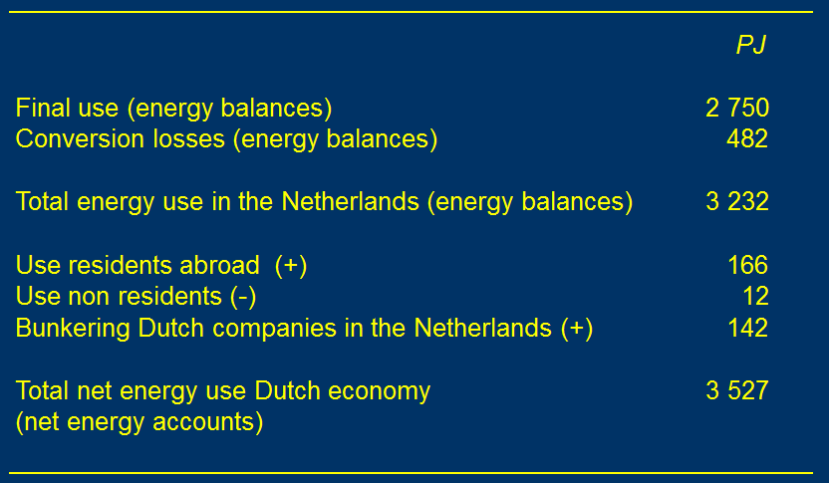
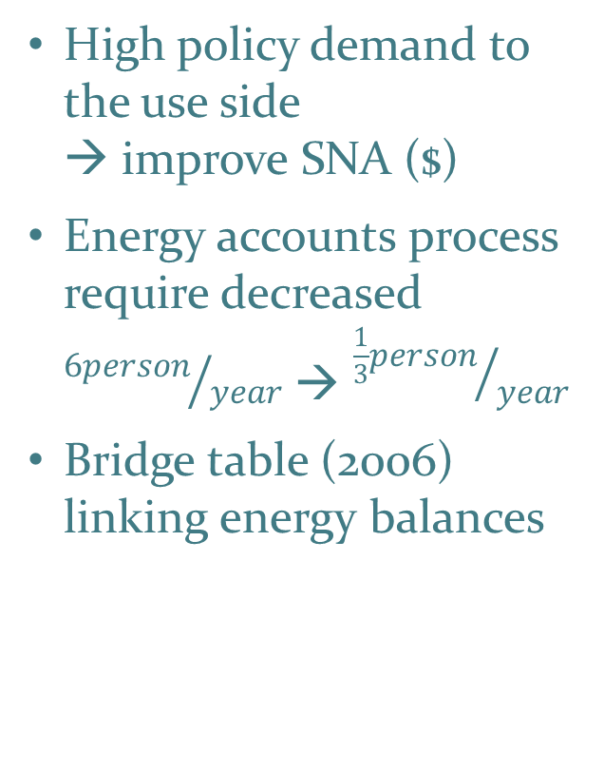
Country examples: Netherlands
4. Level 2
High policy demand to the use side
→ improve SNA ($)
Energy accounts process require decreased ${6person}/{year}$ → ${\frac{1}{3}person}/{year}$
Bridge table (2006) linking energy balances
Sjoerd Schenau, Statistics Netherlands

Slide 51
Discussion
4. Level 2
Which aspects are most relevant to begin with in your country (electricity, fossil fuels, efficiency, access)?
What are the main institutional challenges (data sharing, data access, expertise…)?
Notes:
Suggest to ask each country group for their insights.

Slide 52
References
References
International Recommendations on Energy Statistics (2016) http://unstats.un.org/unsd/energy/ires/
SEEA-Central Framework (2014) http://unstats.un.org/unsd/envaccounting/seeaRev/SEEA_CF_Final_en.pdf
SEEA-Energy (Draft) http://unstats.un.org/unsd/envaccounting/seeaE/GC_Draft.pdf
Energy Statistics Compilers Manual http://unstats.un.org/unsd/energy/ESCM.htm
IEA/Eurostat: Energy Statistics Manual http://www.iea.org/publications/freepublications/publication/energy-statistics-manual.html
Eurostat: Physical Energy Flow Accounts http://ec.europa.eu/eurostat/web/environment/methodology
EuroStat. Physical Energy Flow Accounts Builder. http://ec.europa.eu/eurostat/web/environment/physical-energy-flow-accounts.
  Standard International Energy Product Classification (SIEC) (2011) http://unstats.un.org/unsd/class/intercop/expertgroup/2011/AC234-14.PDF

Slide 53
Acknowledgements
Acknowledgements
Materials prepared by:
  Michael Bordt
    Regional Adviser on Environment Statistics
    ESCAP Statistics Division
    bordt@un.org
  Rikke Munk Hansen
    Chief, Economic and Environment Statistics Section
    ESCAP Statistics Division
    hansenrm@un.org
  Hye Kyeong Choi
    Consultant on Environment Statistics
    ESCAP Statistics Division
    gracechoi0102@gmail.com
Materials adapted from:
  Joe St. Lawrence (Statistics Canada; UNSD SEEA Training of Trainers Seminar; 7-10 July 2015, Santiago)
  Laura Binns (ABS; Regional Training Workshop on the SEEA; 26-30 Sept. 2016; Putrajaya, Malaysia)
  Ole Gravgård (Statistics Denmark; SEEA Training Seminar for the ECA; Addis Ababa 2-5 Feb. 2015)
  Sjoerd Schenau (Statistics Netherlands and Eurostat course on Environmental Taxes)
  Sokol Vako (UNSD; Nov. 17, 2015; Regional Training Workshop on the SEEA; Shanghai)

Slide 54
Thank you!

Slide 55
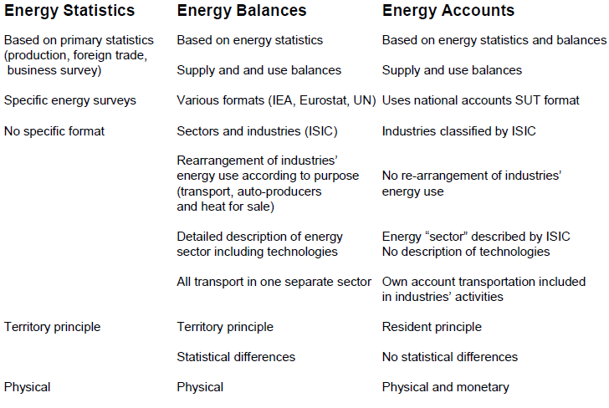
Energy statistics, balances and accounts
Annex
Notes:
Need note on what statistics, balances and accounts are good for and why they can co-exist:
Energy statistics (e.g., IRES): common concepts, units, classifications, conversion factors; social dimension (e.g., distribution and household expenditures on energy)
Energy balances: purpose/activity of use (e.g., transport); link to IPCC/territorial; net consumption?
Energy accounts: link to SNA/residential (all residents regardless of location); efficiency measures; calculate air emissions; includes own-generation
Energy policy concerns: availability, distribution (equity), supply/security, economic benefits/sustainability; emissions/renewables; hazards/spills

