Slide 1
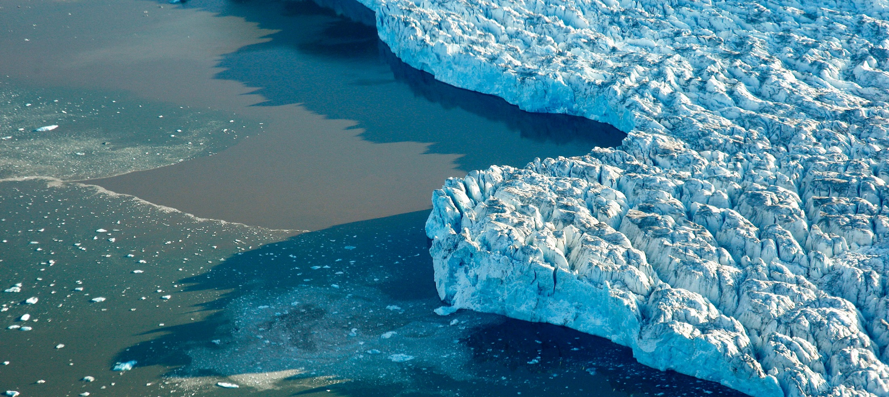

Water Emissions

Slide 2
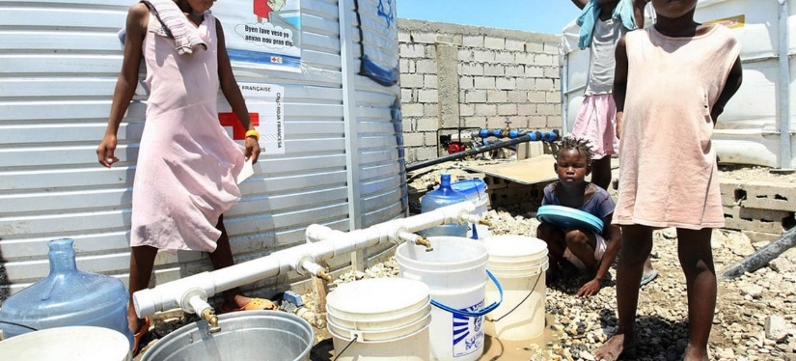

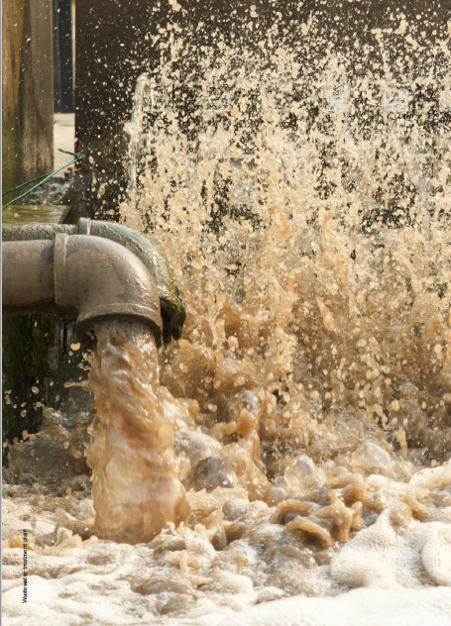
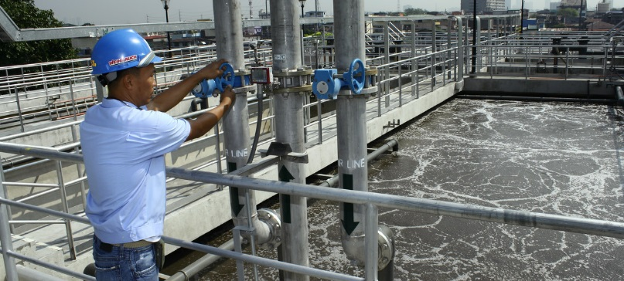
Outline
Outline
1. Learning objectives
2. Review of basics (5m)
3. Level 1 What? Why? (Compilers)
  Concepts (15m)
  Group exercise & Discussion (30m)
4. Level 2 (Data providers)
  Data options, examples & issues (15m)
  Group exercise & Discussion (15m)
5. Closing Discussion (10m)
Manila
Notes:
This will be a combination presentation, group exercise and discussion. The entire process will take about 90 minutes.
Before we start, I’d like to emphasize that I recognize that some of you will be more expert than I in some of the topics we will discuss.
One objective, is to bring everyone to the same level of understanding of this topic. This requires a simplification of the principles and concepts.
The training unit is still being developed and I look forward to your input to improve it.

Slide 3
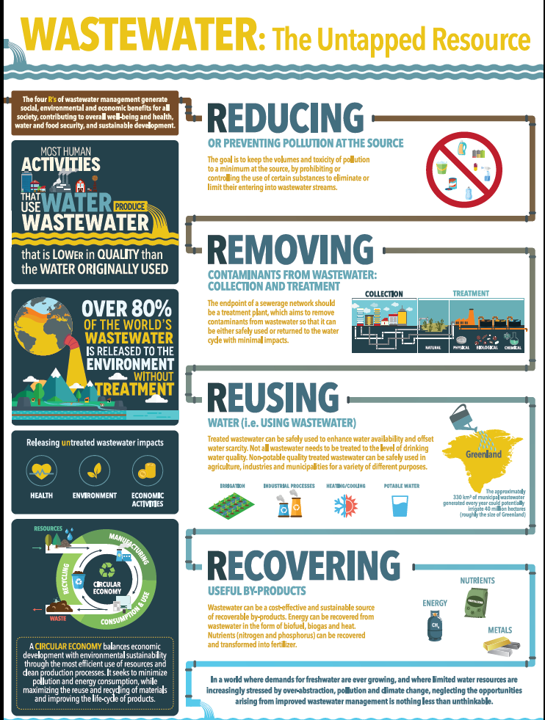
Learning objectives: Levels 1 and 2
Learning Objectives
  Level 1:
    Understand why Emissions to Water are important and how they link to policy
    Understand the basic concepts of Accounting for Emissions to Water
    Understand how water is treated in the SEEA
    Learn the steps of compiling a Water Emissions Account
  Level 2:
    Understand the data options and sources
    Understand the important conceptual issues
    Be aware of how other countries have approached Water Emissions Accounting
Notes:
Please ask questions and comment during the presentation (as long as you keep it high level = clarification, correction)

Slide 4
Are we polluting our water assets?
2. Review of basics
Renewable supply
The economy
Abstraction & Use
Emissions
Water Assets
Returns

Slide 5
Are we polluting our water assets?
2. Review of basics
Renewable supply
Water Assets (stock)
Abstraction and use
Returns

Slide 6
Water emissions accounting
2. Review of basics
What?
  Effluent: quantity of wastewater in m³ (regardless of quality)
  Emission: quantity of substance in the effluent (in tonnes)
Why?
  Policies on water quality & security, resources management
  Links to economic accounts (EPE, intensities)
  Basis for SEEA-WATER, SEEA-EEA (ecosystems), FDES 3.2
  Indicators:
    Total water emissions supply (who makes it?)
    Total water emissions (who treats it?)
    Water emissions intensity/productivity (who makes the most?)
    Treatment capacity (is there enough?)

Slide 7
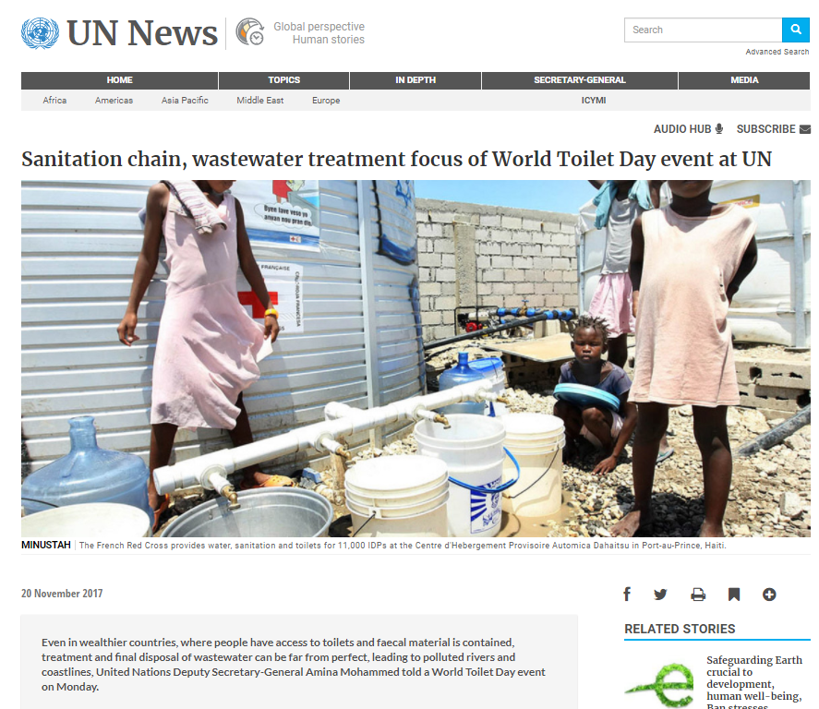
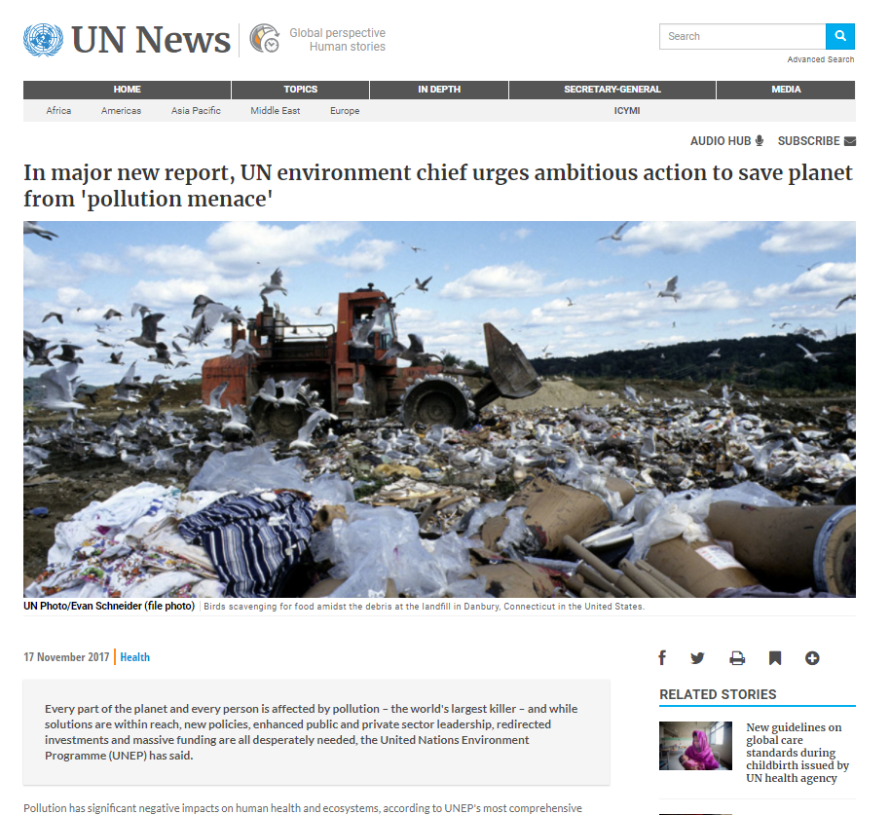
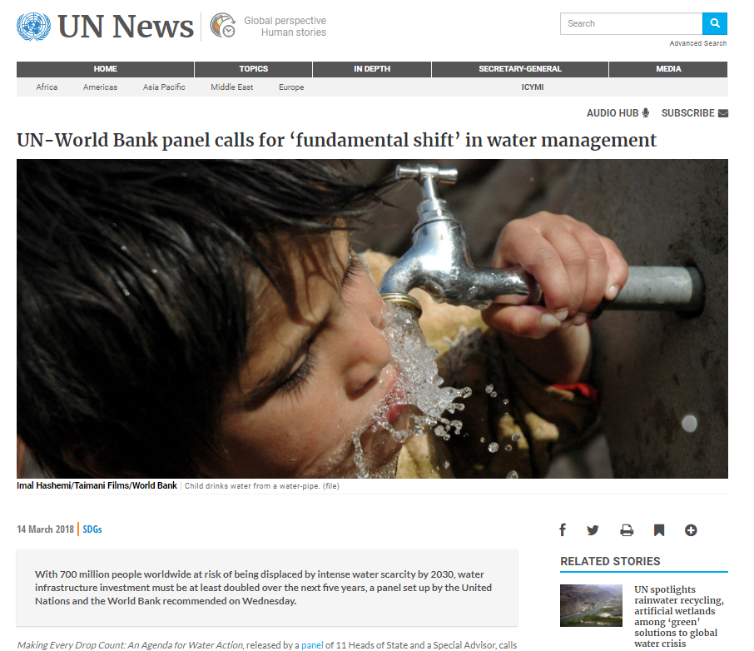
Waste water in the news
2. Review of basics

Slide 8
What is the problem?
2. Review of basics
We put things into the water stream:
  Pathogens, poisons, metals: Make us & ecosystems sick
  Organic materials: Cause eutrophication (too little oxygen)
  Heat: Changes in ecosystems
  Emerging issue: microbeads, microplastics (effect not certain)
Untreated wastewater returns to
  Water supply (need to treat it again)
  Environment (soil, runoff to rivers, groundwater, ocean)
Emissions to water is
  a waste that can be captured & reused

Slide 9
Water Emissions Account
3. Level 1
Learning objectives
Review of Level 0 (5m)
Level 1 (Compilers)
  Concepts (15m)
  Group exercise & Discussion (30m)
Level 2 (Data providers)
  Data options, examples & issues (15m)
  Group exercise & Discussion (15m)
Closing Discussion (10m)

Slide 10

In simple terms…
3. Level 1
Generation
  What, how much and by whom?
Collection, treatment and reuse
  Waste Water Treatment Plants (WWTP)
    Reuse of water (usually cleaner)
    Reuse pollutants removed
Discharge to environment
Releases in wastewater
106
Pollutants in water for reuse
4
Pollutants removed by WWTPs
6
Waterborne emissions to the environment
34
Source: UNSD 2014

Slide 11
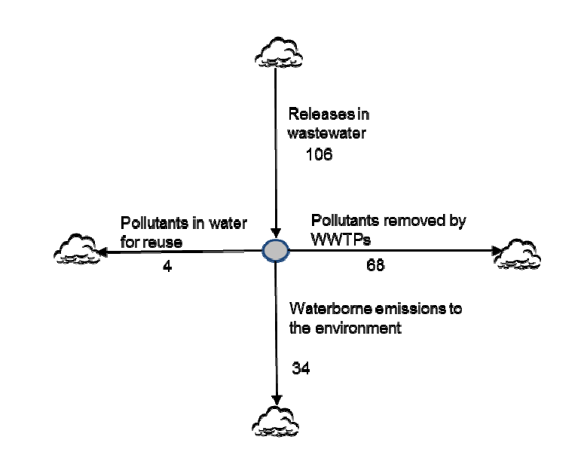
In simple terms…
3. Level 1
Generation
  What, how much and by whom?
Collection, treatment and reuse
  Waste Water Treatment Plants (WWTP)
    Reuse of water (usually cleaner)
    Reuse pollutants removed
Discharge to environment
Source: UNSD 2014

Slide 12
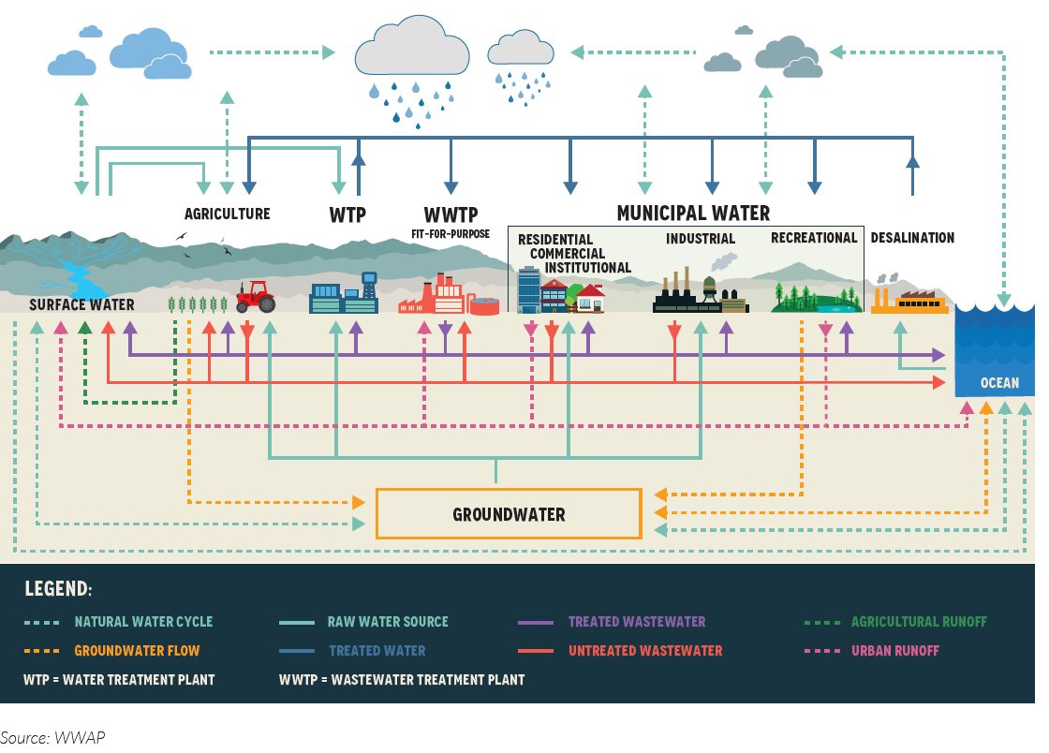
Water emissions in the water cycle
3. Level 1
Water emissions flows
Source: WWAP

Slide 13
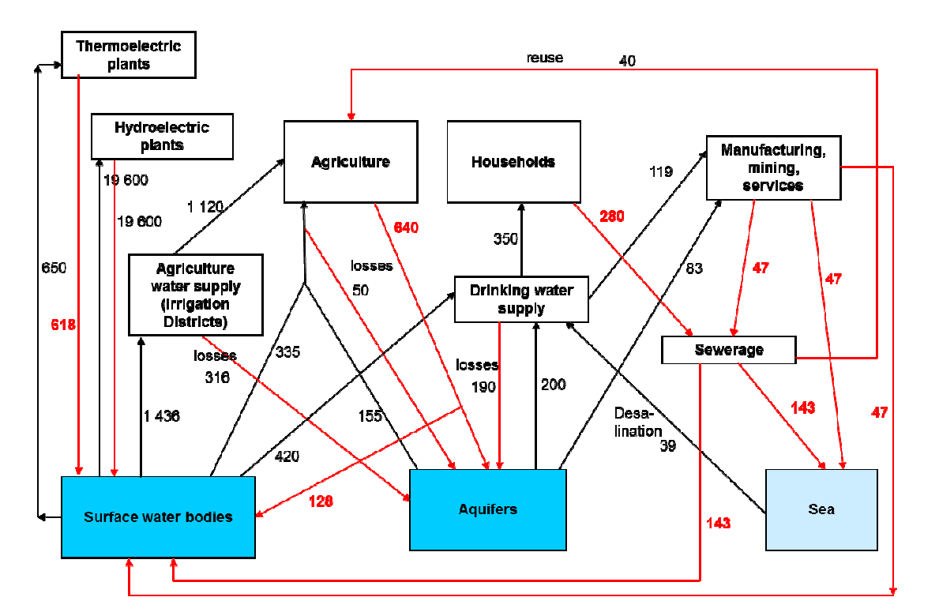
Measuring it: red lines are wastewater!
3. Level 1
Source: UNSD 2014
Notes:
The water PSUT don’t say what’s in it.

Slide 14
What does a Water Emissions Account look like?
3. Level 1
Start with gross volumes of water released (m³):
To establish flows to environment or to treatment
SEEA Water Supply/Use provides estimates of volumes of water treated and discharged
Include…
Point sources: sewerage facilities, power plants, industry
Non-point sources: urban runoff, agriculture
Estimate quantities of substances
From concentrations
From “factors” (e.g., per household per day, per m³ effluent)
Select relevant substances (tonnes)
BOD (organic substances)
COD (inorganic substances)
Suspended solids
Phosphorous (nutrient)
Nitrogen (nutrient)
Solid wastes dumped into water are in Solid Waste Account
For each, account for…
Supply
Gross releases of substances (tonnes):
Release to other economic units
Use
Emissions received by the environment
Collection by other economic units
Notes:
BOD: Biological Oxygen Demand (organic substances)
COD: Chemical Oxygen Demand (inorganic substances)
Suspended Solids (things you can see) (a.k.a. TSS)
Phosphorous (nutrient) (a.k.a. TP)
Nitrogen (nutrient) (a.k.a. TN, or TKN)

Slide 15
What does a Water Emissions Account look like?
3. Level 1
Start with gross volumes of water released (m³):
  To establish flows to environment or to treatment
  SEEA Water Supply/Use provides estimates of volumes of water treated and discharged
Include
  Point sources: sewerage facilities, power plants, industry
  Non-point sources: urban runoff, agriculture
Estimate quantities of substances
  From concentrations
  From “factors” (e.g., per household per day, per m³ effluent)

Slide 16
What does a Water Emissions Account look like?
3. Level 1
Select relevant substances (tonnes)
  BOD: Biological Oxygen Demand (organic substances)
  COD: Chemical Oxygen Demand (inorganic substances)
  Suspended Solids (things you can see) (a.k.a. TSS)
  Phosphorous (nutrient) (a.k.a. TP)
  Nitrogen (nutrient) (a.k.a. TN, or TKN)
  Note: Solid wastes dumped into water are in Solid Waste Account
For each, account for
  Supply:
    Gross releases of substances (tonnes):
    Releases to other economic units
  Use:
    Emissions received by the environment
    Collection by other economic units

Slide 17
Flows in water emissions accounts
3. Level 1
Industry
(e.g., mining, manufacturing)
Households
Sewage industry
Environment
(e.g., surface water, oceans and seas)

Slide 18
The supply-use chain (kind of)
3. Level 1
Supply (tonnes) | Generation |  |  | From environment | Total
 | Sewage industry | Other industries | Households
Emission of substances by type
Releases to other economic units
Release after treatment
Direct releases
To sewage
Use (tonnes) | Generation |  |  | To environment | Total
 | Sewage industry | Other industries | Households
Emission received by the environment
Collection by other economic units

Slide 19
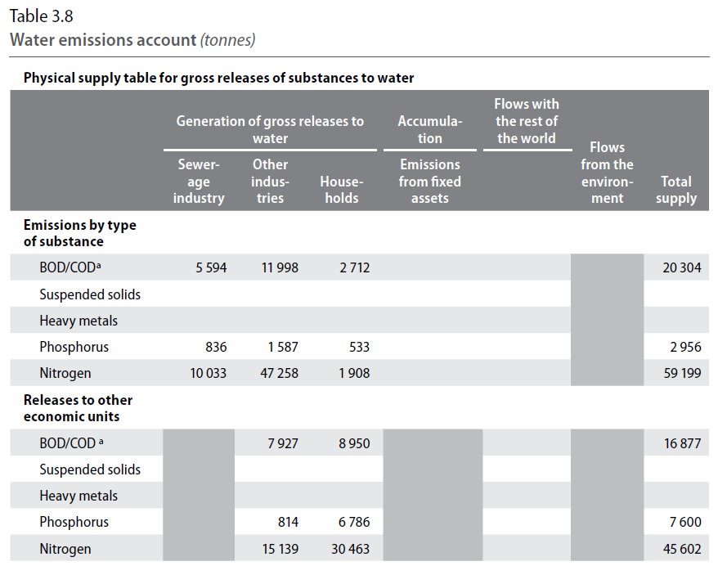
What does a water emissions Account look like?
3. Level 1
Physical supply
Emissions are direct discharge to the environment
Releases to other economic units are amounts sent for treatment
How much BOD/COD do households generate?
What % is untreated?
2,712/11,662 = 23%
2,712 + 8,950 = 11,662
What industry is generating all this?
Agriculture
Notes:
This is simpler than water, energy and physical supply/use for natural inputs.

Slide 20
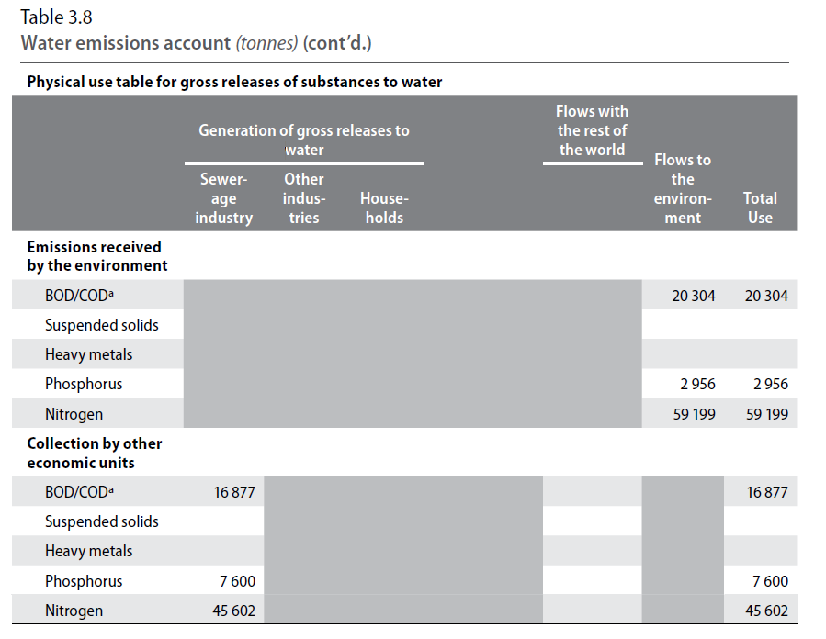
What does a water emissions Account look like?
3. Level 1
Physical use
Emissions received are total discharge to the environment
Collection by other economic units are amounts sent for treatment
If the sewerage industry
Collects 16,877T BOD/COD,
Emits 5,994T (previous slide)
Where does the rest
(10,893T) go?
Solid waste or sludge pond
Notes:
Answer: Solid waste or sludge pond
???: presume returns to water supply from water PSUT? Emissions removed = solid waste

Slide 21

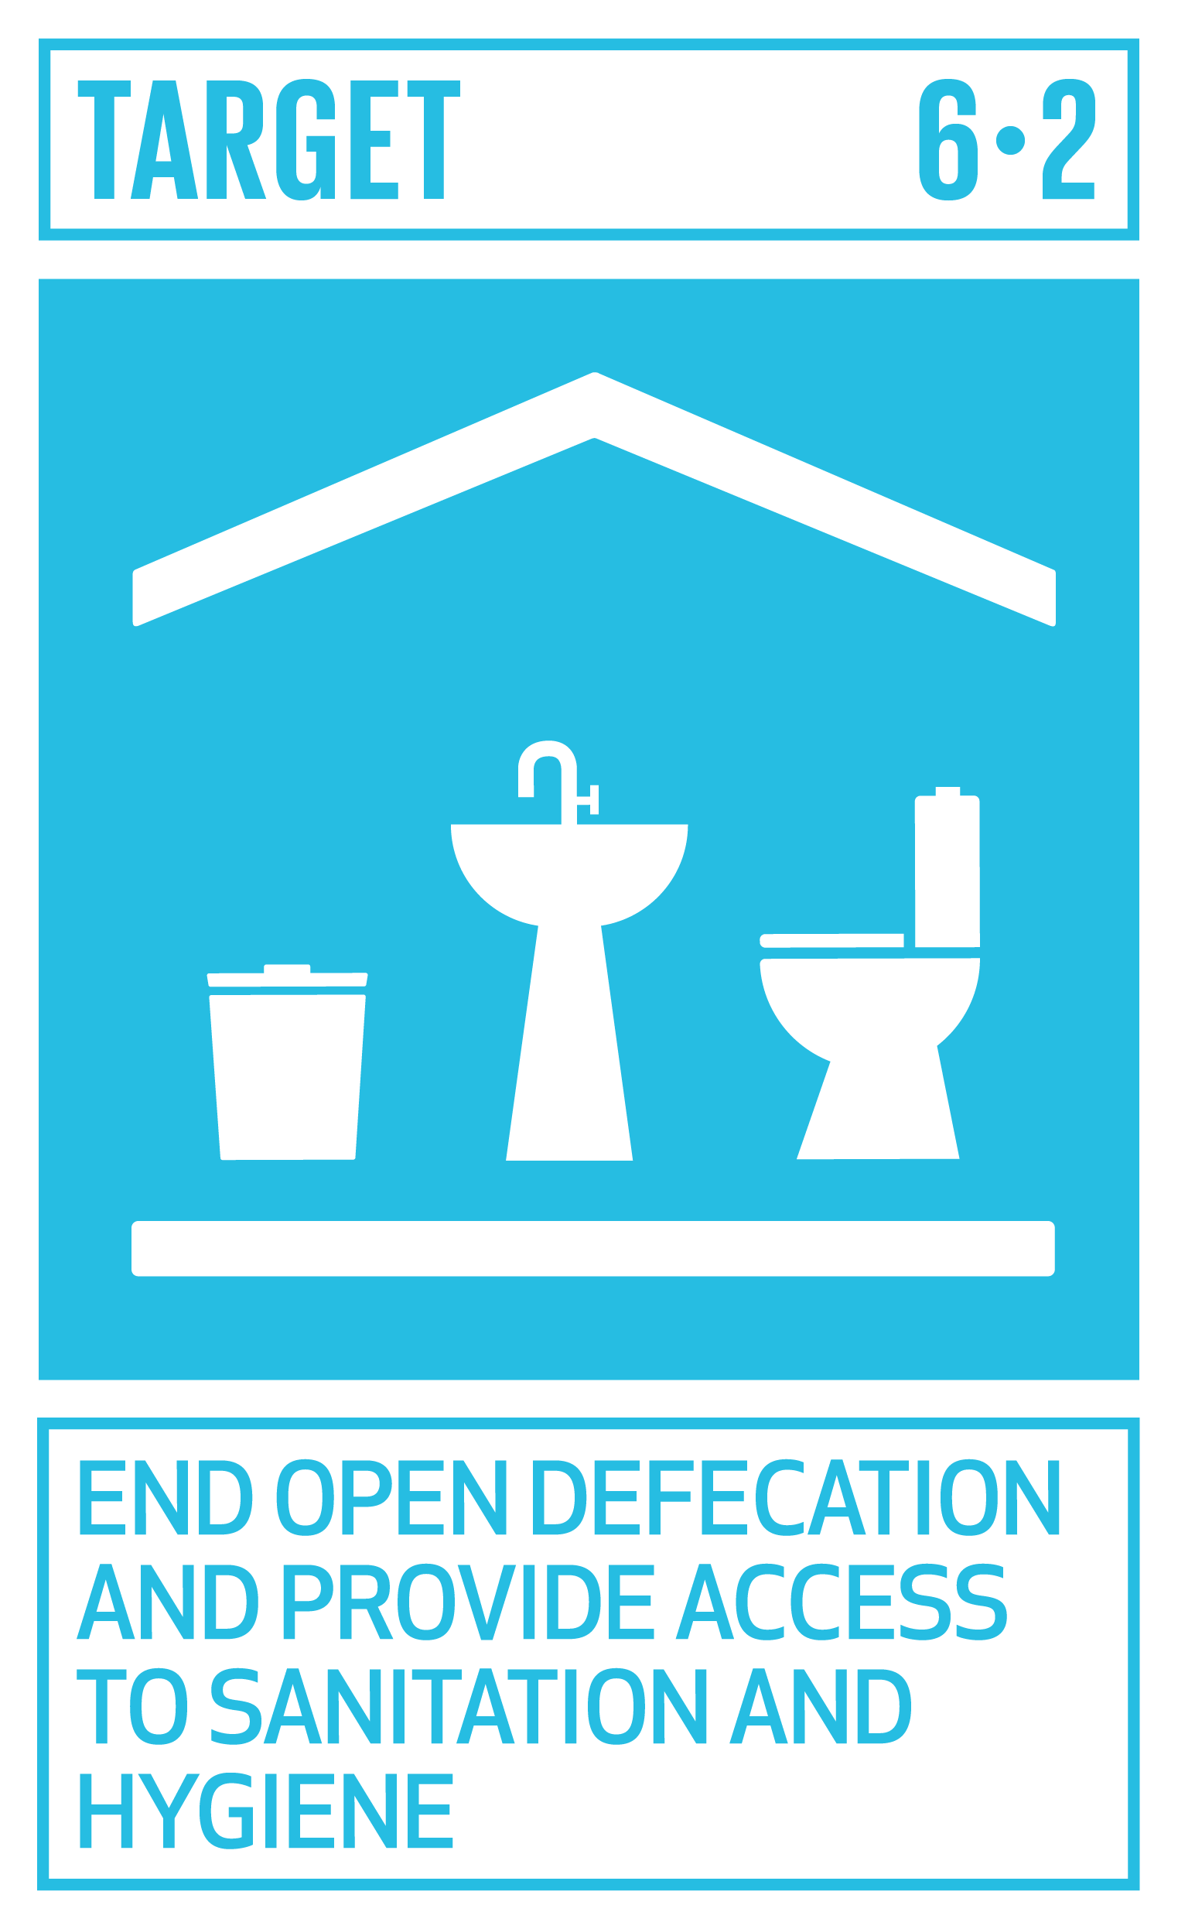
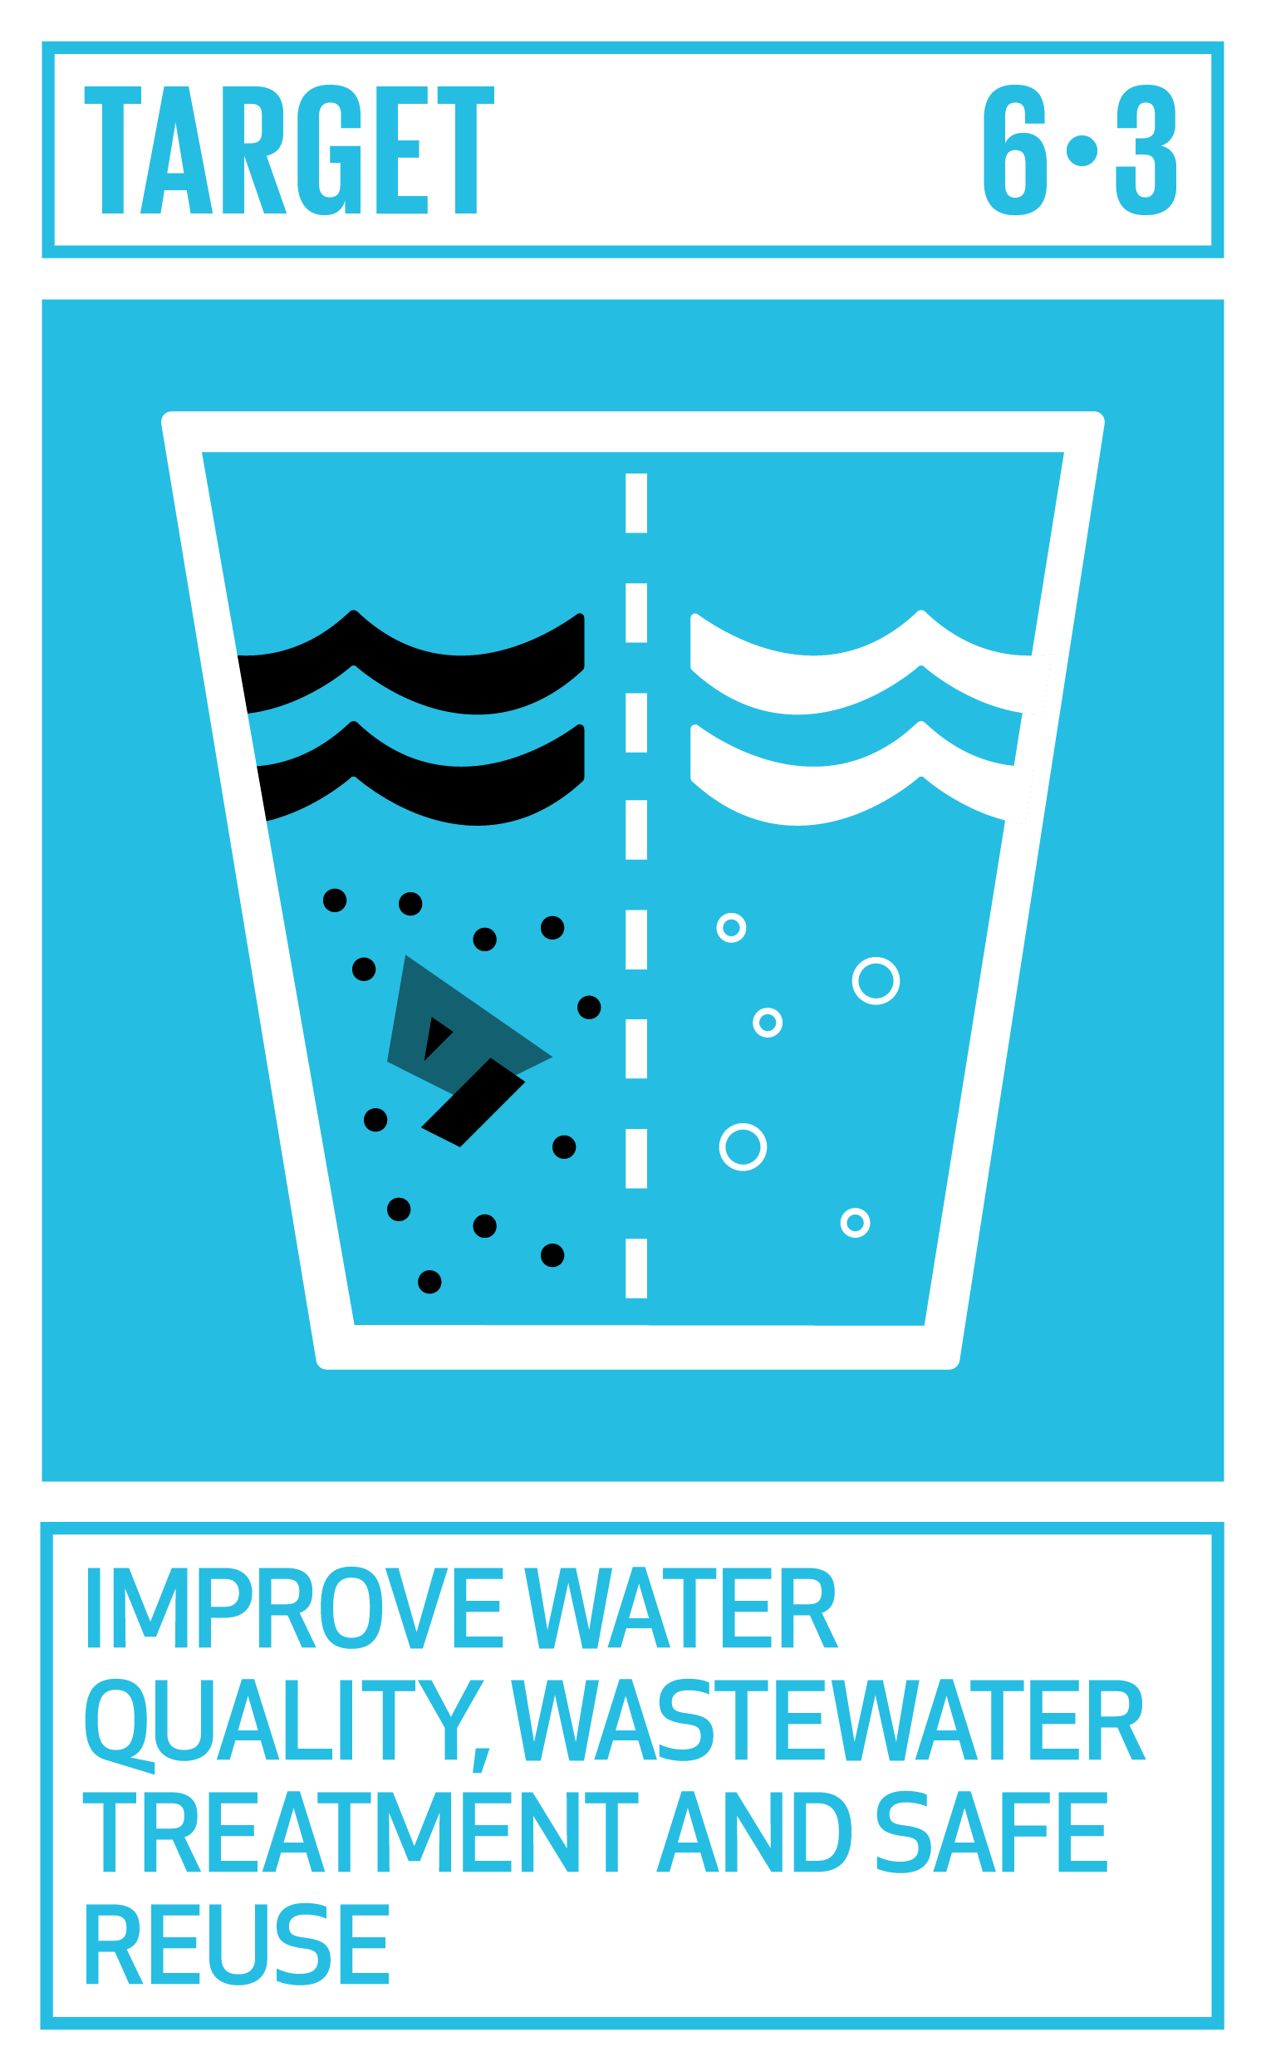
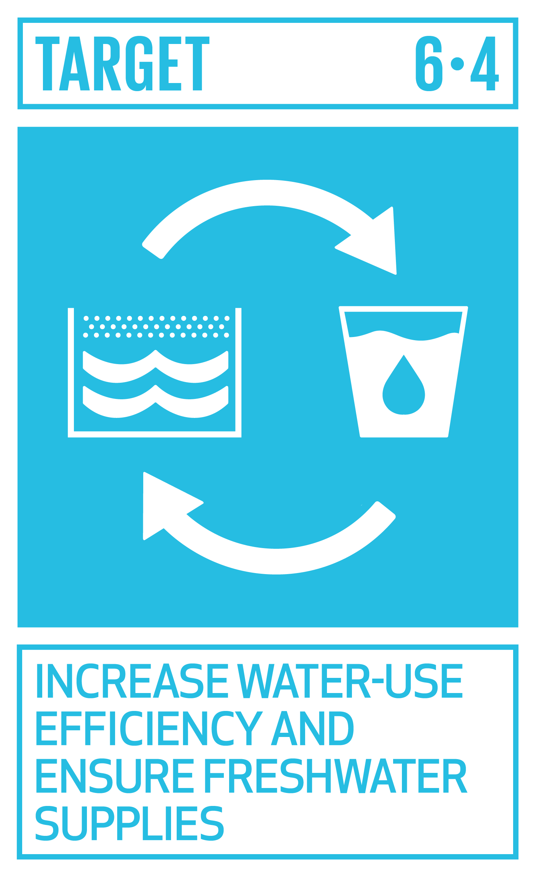
Examples of Water emissions-related SDG indicators
3. Level 1
6.2.1 Proportion of population using safely managed sanitation services
6.3.1: Percentage of wastewater safely treated
6.3.2 Proportion of water bodies with good ambient quality
6.4.2 Level of water stress: freshwater withdrawal as a proportion of available freshwater resources
Notes:
https://ec.europa.eu/eurostat/statistics-explained/index.php/SDG_6_-_Clean_water_and_sanitation_(statistical_annex) : This one has data by year and country
https://unstats.un.org/unsd/envstats/fdes/SDGsInd_BasicSetMatrix.pdf : This one has statistics used in the SDG Indicator corresponding to BSES (SDG indicator can be compiled either fully or partially from BSES statistics)

Slide 22
Compilation Group Exercise (30m)
3. Level 1
Situation:
  Have some source factors and gross discharge amounts
Objective (Groups of 3-5):
  Compile a Water Emissions Account
  Report results
Notes:
For the compilation exercise, we will
Take a simple Stock and Flow diagram and create a Water Asset Account.
Create a Supply and Use Table from a Supply and Use Diagram

Slide 23
The situation
3. Level 1
The country has a population of 50 million
85% are connected to the sewer network
A survey estimates that each person generates:
  60g of BOD/day
  130g of COD/day
  70g of Suspended Solids/day
Per year, agriculture applies 5MT of phosphorous and 10MT of nitrogen. All is emitted to the environment.
Industry discharges 5Mm³ of water per year. Tests show that, after own treatment, the average concentration of:
  Heavy metals is 3.2g/m³
  COD is 2.5kg/m³
The sewage industry is 80% efficient in removing BOD, COD and Suspended Solids
Compile the water emissions supply and use tables below.
What are the totals discharged to the environment?

Slide 24
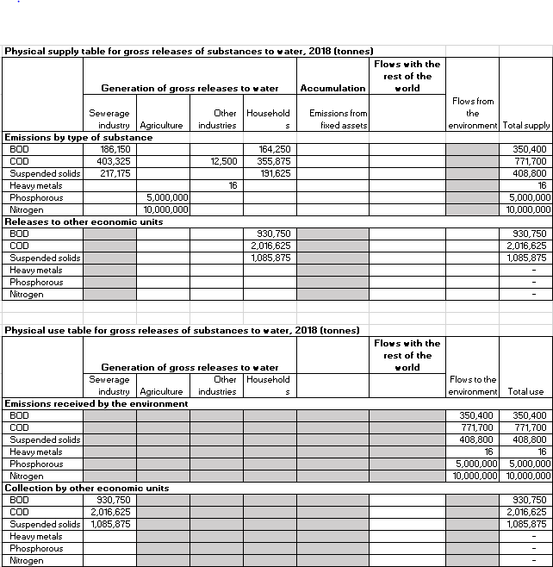
The answers
3. Level 1
Water Emissions Account
Per day, 50 million people generate
  60g BOD
  130g COD
  70G TSS
85% is treated
50,000,000 * .06 * 365/1000 *.85
15% is released to the environment
50,000,000 * .06 * 365/1000 *.15

Slide 25
The answers
3. Level 1
Water Emissions Account
Agriculture applies 5MT Phosphorous and 10MT Nitrogen
Industry discharges 5Mm³ wastewater
COD is 2.5kg/m³
5,000,000 * 2.5/1000
Heavy metals are 3.2g/m³
5,000,000 * .0032/1000
Totals emitted to environment

Slide 26
The answers
3. Level 1
Water Emissions Account
Per day, 50 million people generate
  60g BOD
  130g COD
  70G TSS
85% is treated
50,000,000 * .06 * 365/1000 *.85
15% is released to the environment
50,000,000 * .06 * 365/1000 *.15

Slide 27
The answers
3. Level 1
Water Emissions Account
Agriculture applies 5MT Phosphorous and 10MT Nitrogen
Industry discharges 5Mm³ wastewater
COD is 2.5kg/m³
5,000,000 * 2.5/1000
Heavy metals are 3.2g/m³
5,000,000 * .0032/1000
Totals emitted to environment

Slide 28
Water Account
4. Level 2
Learning objectives
Review of Level 0 (5m)
Level 1 (Compilers)
  Concepts (15m)
  Group exercise & Discussion (30m)
Level 2 (Data providers)
  Data options, examples & issues (15m)
  Group exercise & Discussion (15m)
Closing Discussion (10m)

Slide 29
Types of water emissions and sources
4. Level 2
Group | Pollutant
Pathogens | Viruses, bacteria, helmiths
Organic matter | Bio-degradable
Nutrients | Nitrogen
 | Phosphorous
Poisonous substances | Metals
 | Persistent Organic Pollutants (POPs), PCBs, PBTs, etc.
Other | Heat
 | Colour
 | Microbeads/plastics
*You can find main sources of the pollutants in Annex

Slide 30
Good news! You don’t need to measure (much)
4. Level 2
Data:
  Household emissions estimated from factors
    e.g., One household discharges 60g/day BOD
  Agriculture discharges all pesticides and fertilizers applied
  Industries are often regulated to limit emissions (standard)
    e.g., Plant xxx averages 100m³ effluent per day, BOD is 2.5kg/m³
  Industries may need to report on quantities released
    e.g., via Pollutant Release and Transfer Registry (PRTR)
Expertise:
  Statisticians
  Industrial engineers (to estimate discharge)
  Water supply and treatment specialists
Notes:
Discussion? E.g., what are the priorities, opportunities and constraints in your country to compiling Water Accounts?

Slide 31
Common problems in compilation
4. Level 2
Scope
Sewage treatment only covers amounts collected
(not generated)
Data Quality
Getting data from industries and farms with own treatment
Local emission factors
(urban/rural, high/low income, industry by type…)
Administrative data
Expenditures on fuel (by type), consumption of fuel
Energy utilities
Scale of data
National level data may hide regional variation
Seasonality
Annual averages may hide seasonal variation and extremes
(e.g., seasonal operators, rainy/dry seasons)
Notes:
Scale of data (national level data may hide regional variation)
Seasonality: Annual averages may hide seasonal variation and extremes (e.g., seasonal operators, rainy/dry seasons)

Slide 32
Common problems in compilation
4. Level 2
  Scope
    Sewage treatment only covers amounts collected (not generated)
  Data quality
    Getting data from industries and farms with own treatment
    Local emission factors (urban/rural, high/low income, industry by type…)
  Scale of data (national level data may hide regional variation)
  Seasonality: Annual averages may hide seasonal variation and extremes (e.g., seasonal operators, rainy/dry seasons)
Notes:
These are only a few of the challenges. Still, it’s not difficult to get started to assemble water accounts.

Slide 33
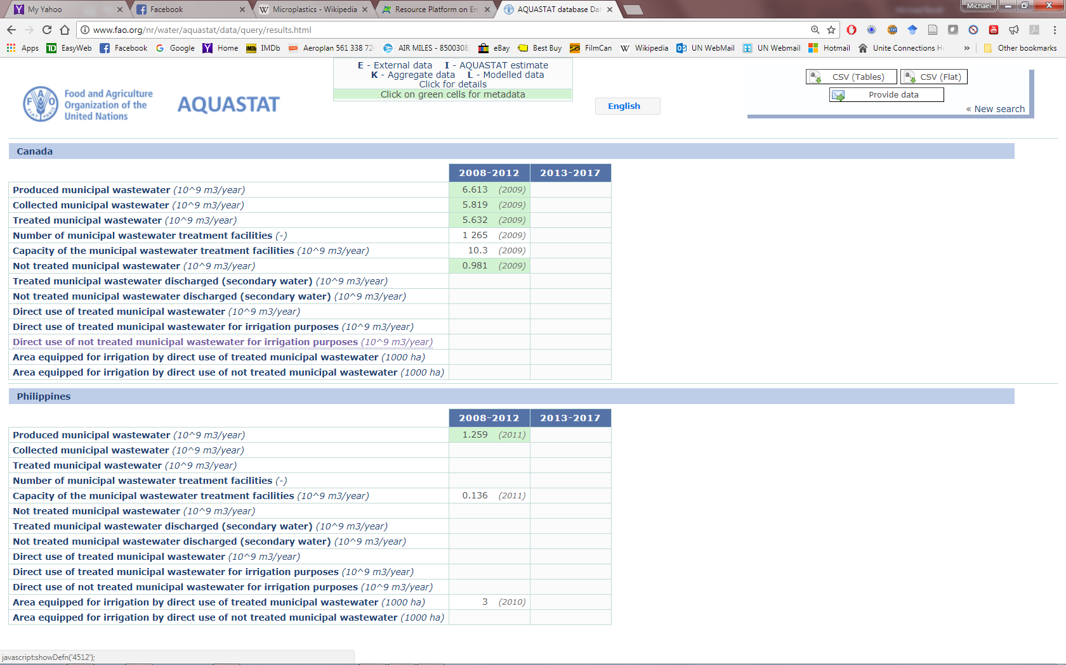
Data options
4. Level 2
Global data sources
  Agricultural fertilizers and pesticides: FAOStat (http://www.fao.org/faostat/en/#data)
  Wastewater (produced, collected, treated, capacity, untreated, use: FAO AquaStat (http://www.fao.org/nr/water/aquastat/data/query/index.html?lang=en)
    Very few data points for the Philippines
Notes:
Not much for the Philippines.

Slide 34
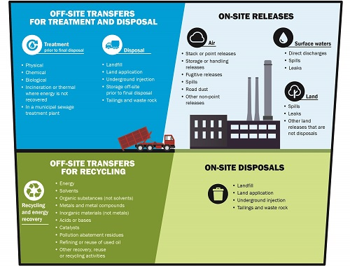
PRTR: Pollutant Release and Transfer Registers
4. Level 2
If your country have PRTR, USE IT!!
OECD: International guidelines & data clearinghouse
Usually large emitters of large quantities
Canada: National Pollutant Release Inventory (NPRI)
  Collected via mandatory questionnaire
  Only specific substances
  Publicly accessible → maps, data
  But…some substances, small emitters, mobile sources not covered
Source: https://www.ec.gc.ca/inrp-npri/

Slide 35
PRTR: Pollutant Release and Transfer Registers
4. Level 2
OECD: International guidelines & data clearinghouse (PRTR)
Usually large emitters of large quantities
Canada: National Pollutant Release Inventory (NPRI)
  Collected via mandatory questionnaire
  Only specific substances
  Publicly accessible → maps, data
  But…some substances, small emitters, mobile sources not covered
Source: https://www.ec.gc.ca/inrp-npri/

Slide 36
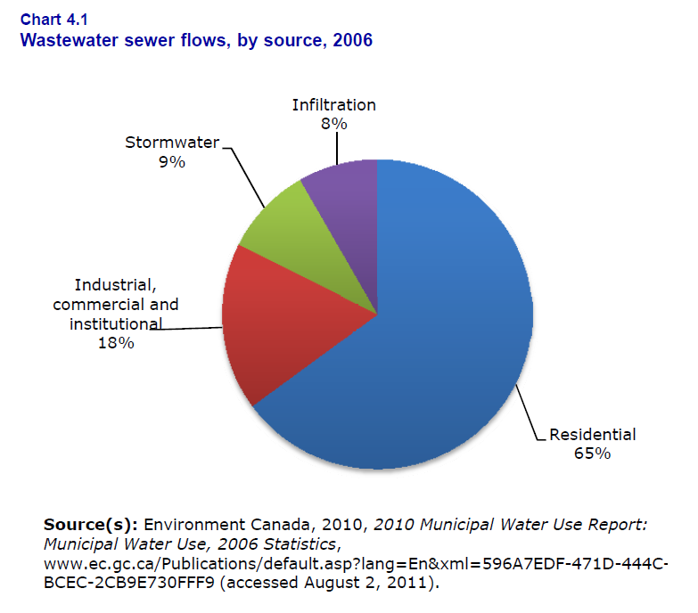
Some Country examples
4. Level 2
Canada:
  Using 3 different sources…
  No compilation of water emission accounts (report wastewater)
National Pollutant Release Inventory (NPRI)
Mandatory reporting of large amounts by large companies (by location)
Drinking Water Plants Survey (DKWP)
Volumes treated, quality of intake, outflow, costs
Survey of Industrial Processes (SIP) (pilot)
Processes in place to limit pollutants (adjunct to NPRI)

Slide 37
Some Country examples
4. Level 2
Canada:
  National Pollutant Release Inventory (NPRI): mandatory reporting of large amounts by large companies (by location)
  Drinking Water Plants Survey (DKWP): Volumes treated, quality of intake, outflow, costs
  Survey of Industrial Processes (SIP) (pilot): processes in place to limit pollutants (adjunct to NPRI)
  No compilation of water emission accounts (report wastewater)
Notes:
No examples from Europe: http://ec.europa.eu/eurostat/statistics-explained/index.php/Environmental_accounts_-_establishing_the_links_between_the_environment_and_the_economy

Slide 38
France 1990s
4. Level 2
Basic statistics, but beginnings of an account
Industries connected to sewers
In preparation of the 1992 water law
Shows the point polluting emissions discharged through sewerage
Households
OM=1.105
TSS=1.745
Pollution eliminated
OM=0.364
TSS=1.745
Sewers
OM=0.609
TSS=1.897
OM=0.885
TSS=1.139
OM=0.583
TSS=0.885
WWTP
OM=0.276
TSS=0.241
OM=Organic Matter
TSS=Total suspended solids.
WWTP=Wastewater Treatment Plants
Natural water bodies
Examples of pollution flows in France (million tons per year)
Ministry of Environment of France, 1990s
Notes:
The following diagram was published in the 1990s by the Ministry of Environment of France in preparation of the 1992 water law. The diagram shows the point polluting emissions discharged through sewerage.

Slide 39
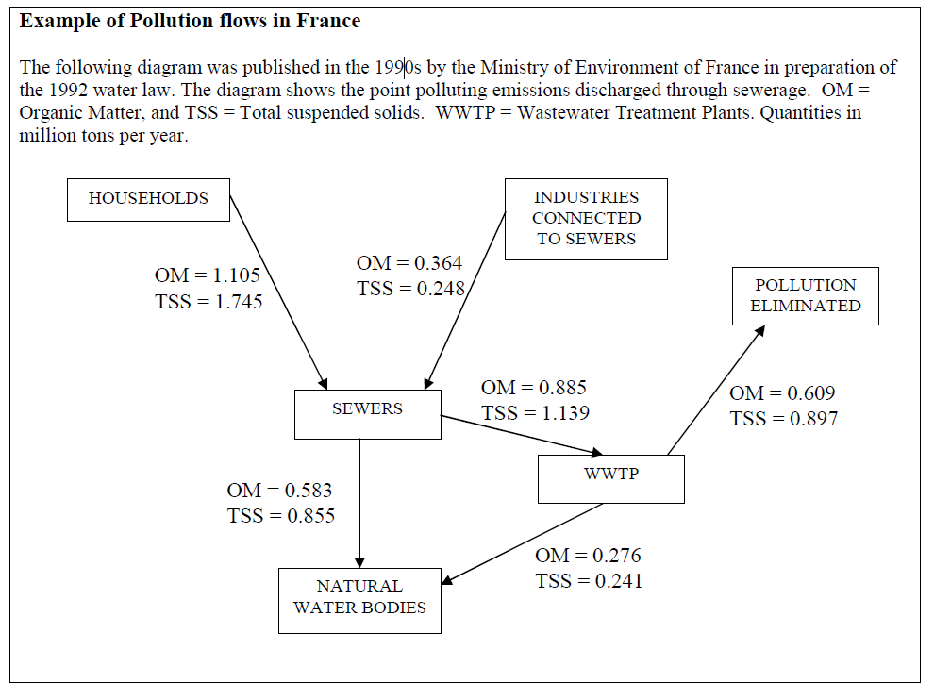
France 1990s
4. Level 2
Basic statistics, but beginnings of an account

Slide 40
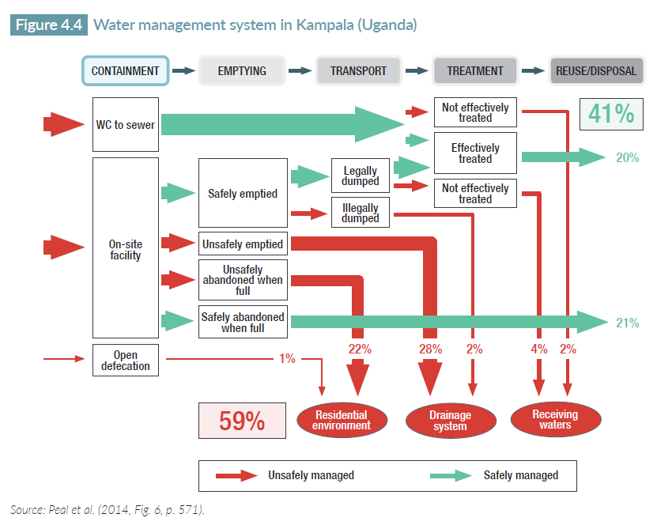
City level: from Peal, et al., 2014
4. Level 2

Slide 41
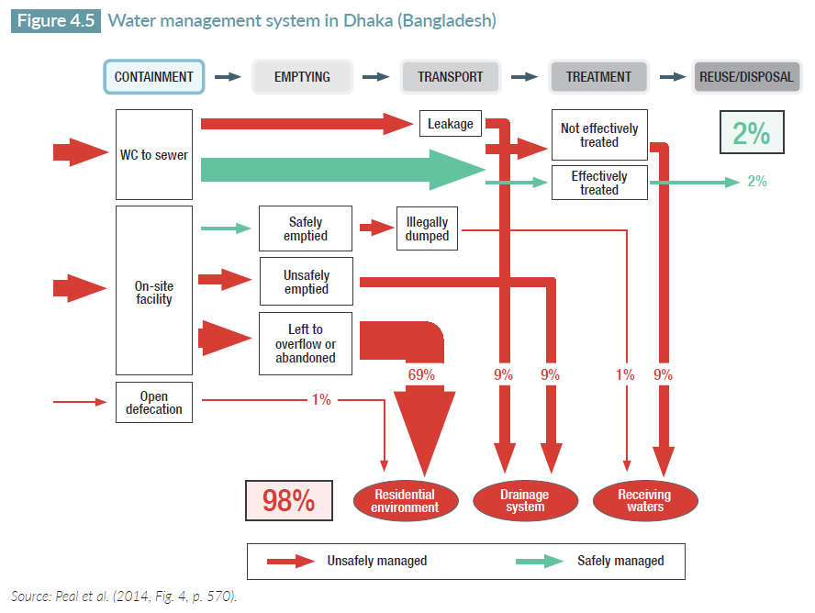
City level: from Peal, et al., 2014
4. Level 2

Slide 42
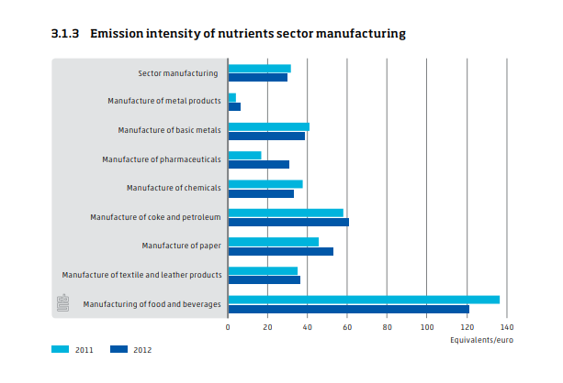
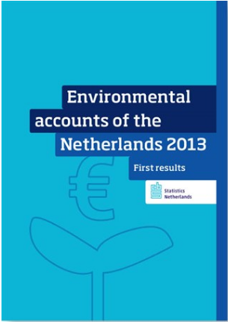

Other countries?
4. Level 2
Netherlands: Nutrients and heavy metals; based on reported emissions (kg); net approach
Measure for the environmental efficiency of production processes
= $\frac{total emission}{value added}$
The most intense polluter
Source: Environment Accounts of the Netherlands 2013
Notes:
The emission intensity is a measure for the environmental efficiency of production processes. It is equal to the total emission divided by value added.
In 2011, the emission intensity of manufacturing as a whole was equal to almost 32 equivalents per euro. In 2012 this decreased slightly to 30 equivalents per euro. Within manufacturing there are significant differences.
The biggest polluter, measured as total emission divided by value added, is manufacturing of food products, with an intensity of more than 136 equivalents per euro in 2011. Here the processing of agricultural products is responsible for the high nutrient emissions. Another big polluter is the sector manufacturing of coke and petroleum (refineries). In 2011 the emission intensity of this sector was 58 equivalents per euro. In 2012 this increased to 60 equivalents per euro. In 2011 manufacturing of food products had a share of more than 80 percent in the total emissions of phosphorus for total manufacturing. In 2012 it came to almost 76 percent. Its share in the total emissions of nitrogen was 58 percent in 2011 and almost 55 percent in 2012. Due to strict standards, the total discharge of nutrients for manufacturing was lower in 2012 than in 2011.

Slide 43
Other countries?
4. Level 2
Netherlands: Nutrients and heavy metals; based on reported emissions (kg); net approach
Source: Environment Accounts of the Netherlands 2013

Slide 44
Other countries
4. Level 2
Denmark: Wastewater and monetary accounts
Others?
  Water emissions is not in EU list
    European environmental accounts: established in Regulation (EU) 691/2011
  The regulation includes…
    Air emissions accounts (AEA)
    Economy-wide material flow accounts (EW-MFA)
    Physical energy flow accounts (PEFA)
    Environmental taxes
    Environmental goods and services sector (EGSS) accounts
    Environmental protection expenditure accounts (EPEA)
  Other European environmental accounts…
    Forest accounts
    Environmental subsidies and similar transfers accounts
Notes:
European Environmental accounts
- The regulation provides a legal framework for a harmonized collection of comparable data from all EU member states and EFTA countries. It is consistent with the SEEA 2012 CF and structured in modules. But only some parts of the CF are presently implemented (6 modules)

Slide 45
Take home points
Take home points
Water Emission Accounts track quantities of pollutants in wastewater
  Monitor policies to reduce pollution; reduce water waste
Link to
  SEEA Water PSUT: Volume of water treated & released
  SEEA Solid Waste: Disposition of collected emissions
  SEEA EPE: Expenditures on wastewater management
  Links to FDES 3.3.2: Generation and management of wastewater
Data sources include emission factors, release reports, effluent quality monitoring
Main challenges: local factors, data from many sources

Slide 46
Discussion
Discussion
What are the priorities?
  Which pollutants: BOD, COD, metals, nutrients, pharma?
  Which stage: generation, municipal treatment, release to environment, water reclamation?
What data are available?
Who else should be consulted?
For tomorrow:
  Look for national data for generation, treatment and release of emissions to water (nothing in CPES 2014?)
  Household, industrial factors

Slide 47
References
References
OECD PRTR (Pollutant release and transfer registry): http://www.oecd.org/chemicalsafety/pollutant-release-transfer-register/
Peal, A., Blackett, I., Hawkins, P. M. and Heymans, C. 2014. Fecal sludge management: A comparative analysis of 12 cities. Journal of Water Sanitation and Hygiene for Development, Vol. 4, No. 4, pp. 563–575. doi:10.2166/washdev.2014.026
Sato, T., Qadir, M., Yamamoto, S., Endo, T. and Zahoor, A. 2013. Global, regional, and country level need for data on wastewater generation, treatment, and use. Agricultural Water Management, Vol. 130, pp. 1–13. dx.doi.org/10.1016/j.agwat.2013.08.007
SEEA-Central Framework: http://unstats.un.org/unsd/envaccounting/seeaRev/SEEA_CF_Final_en.pdf
SEEA-Agriculture, Forestry and Fisheries: http://unstats.un.org/unsd/envaccounting/aff/2GC_Draft.pdf
UNSD. 2014. Guidelines for the Compilation of Water Accounts and Statistics (Draft). https://seea.un.org/content/water
WWAP (United Nations World Water Assessment Programme). 2017. The United Nations World Water Development Report 2017. Wastewater: The Untapped Resource. Paris, UNESCO. http://www.unesco.org/new/en/natural-sciences/environment/water/wwap/wwdr/2017-wastewater-the-untapped-resource/

Slide 48
Acknowledgement
Acknowledgement
Materials prepared by:
  Michael Bordt
    Regional Advisor on Environment Statistics
    ESCAP Statistics Division
    bordt@un.org
    More self-learning resources on: http:/communities.unescap.org/environment-statistics
  Hye Kyeong Choi
    Consultant on Environment Statistics
    ESCAP Statistics Division
    gracechoi0102@gmail.com
Materials adapted from:
  Original work from SEEA-CF manual
  seea@un.org

Slide 49
Types of water emissions and sources (1)
Annex
Group | Pollutant | Main source
Pathogens | Viruses, bacteria, helmiths | Human waste: Households, Hospitals, Hotels, …
Organic matter | Bio-degradable | Households Food industries
Nutrients | Nitrogen | Fertilizer in returns and runoff from agricultural fields Discharges from WWTPs
 | Phosphorous | Fertilizer in returns and runoff from agricultural fields; Discharges from WWTPs Detergents in sewage

Slide 50
Types of water emissions and sources (2)
Annex
Group | Pollutant | Main source
Poisonous substances | Metals | Urban runoff Steel industry Industries using electroplating Agriculture (pesticides, herbicides, defoliants include arsenic) Industries using coal (lead) Refrigeration and air conditioning (cadmium) Leather tanning (chromium)
 | Persistent Organic Pollutants (POPs), PCBs, PBTs, ets. | Agriculture (pesticides using DDT) Electric components (PCBs for cooling) Pharma industries and households: pharmaceuticals
Other | Heat | Thermo-electric plants (cooling water)
 | Colour | Tanning, dyeing industries
 | Microbeads/plastics | Toothpaste, cosmetics, soap, textiles,…
Notes:
PCB = Polychlorinated biphenyl
PBT= Persistent, bioaccumulative and toxic substances

